Slide 1

Advanced Analytics for Real Estate®
ValueScape Analytics, Inc., proprietary and confidential information, all rights reserved.

Slide 2
OUR MANTRA
“We want to help appraisers and collateral reviewers to properly evaluate collateral value and interpret risk by generating more credible, transparent, and defensible valuations"
ValueScape Analytics, Inc., proprietary and confidential information, all rights reserved

Slide 3
ValueScape analytics
Incorporated May 2013
Minority owned California corporation
Focused on mobile and advanced analytics
Unparalleled expertise in valuation and analytic products
First product offering: Valuation Navigator™
Available in Apple App Store
Production ready
Master Services Agreement signed with Quicken Loans/TSI Appraisals
3 year conceptual and development effort
US Patent pending, 40+ innovation claims
ValueScape Analytics, Inc., proprietary and confidential information, all rights reserved

Slide 4
THE BIG PICTURE
Dealing with Valuation Risk and Information Overload
ValueScape Analytics, Inc., proprietary and confidential information, all rights reserved

Slide 5
The big picture
Dealing with and managing Risk
The need for better data
The need for better analytics
The push towards transparency
Credibility and Supportability
ValueScape Analytics, Inc., proprietary and confidential information, all rights reserved

Slide 6
our approach
ValueScape combines innovative analytics and mobile technologies into a disruptive innovation to complete a valuation analysis and audit trails on any property from a mobile device.
ValueScape Analytics, Inc., proprietary and confidential information, all rights reserved

Slide 7



ValueScape approach
A Mobile app, Valuation Navigator™, moving the quality control aspects to the front-end of the appraisal process.
End-To-end valuation solution.
Not a companion product.
Robust out-of-the box data from leading national data sources.
Analyze markets thoroughly and complete an appraisal report within the iPad.
Available in Apple's App Store.
ValueScape Analytics, Inc., proprietary and confidential information, all rights reserved

Slide 8
Our buzz
"I see that you are forward thinkers“
“I am now one of your fans"
“This is the coolest application that I have ever seen”
“You guys are going to transform the industry”
ValueScape Analytics, Inc., proprietary and confidential information, all rights reserved

Slide 9
TECHNOLOGY
ValueScape Analytics, Inc., proprietary and confidential information, all rights reserved

Slide 10
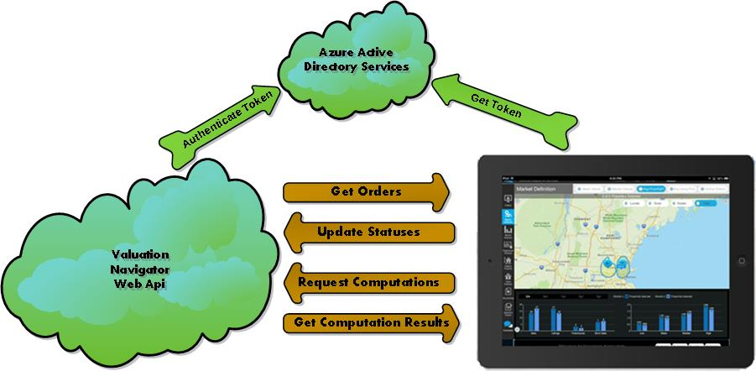
Mobile cloud computing

Slide 11
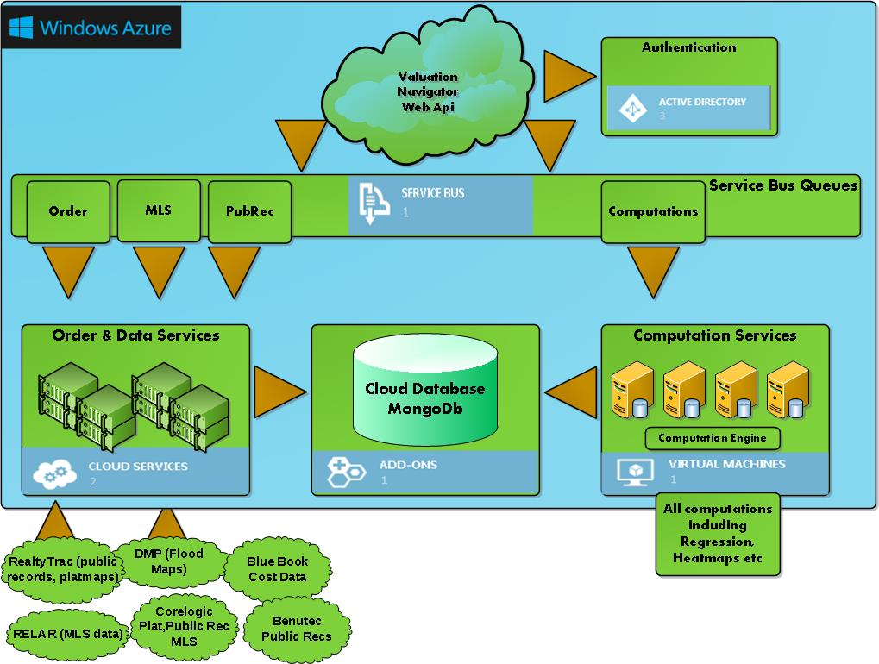
VALUESCAPE CLOUD
Mathematica!

Slide 12
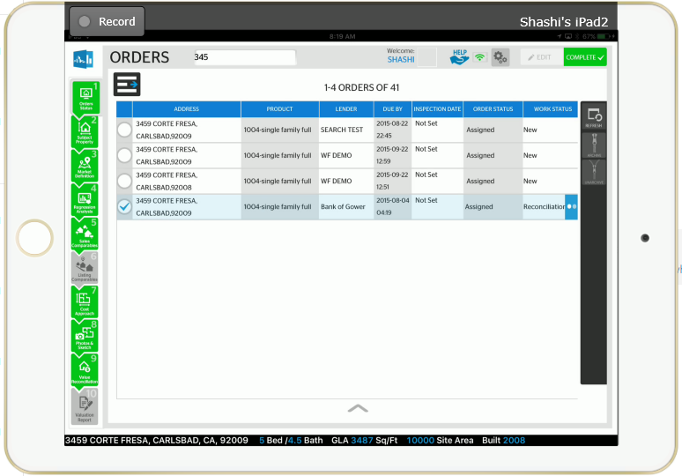
Mobile app - orders

Slide 13
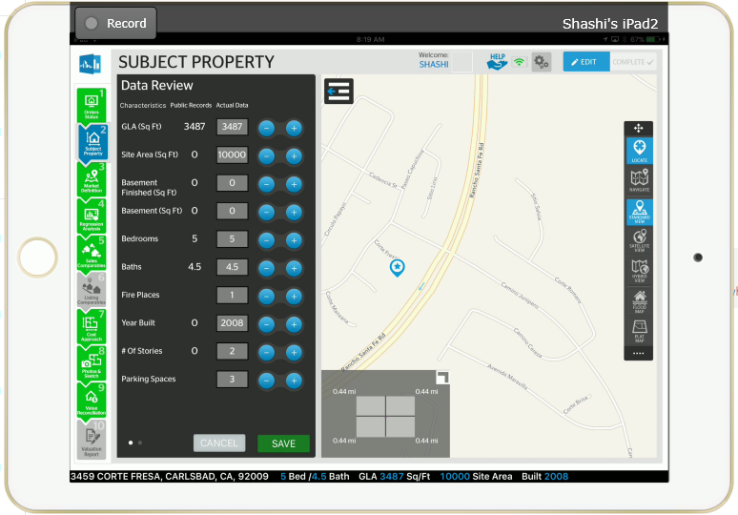
Subject property

Slide 14
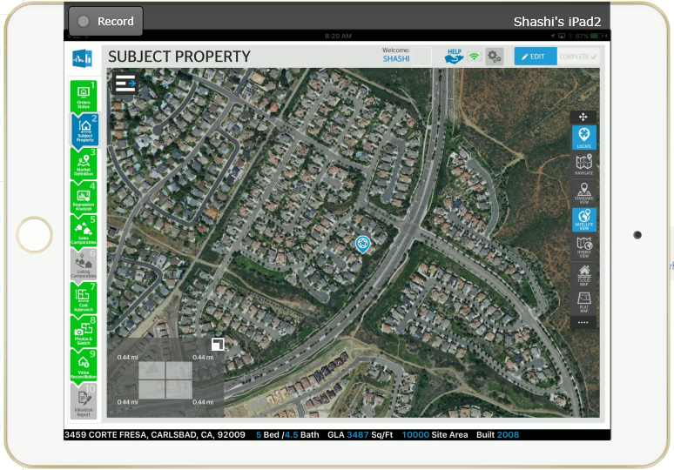
subject property on map

Slide 15
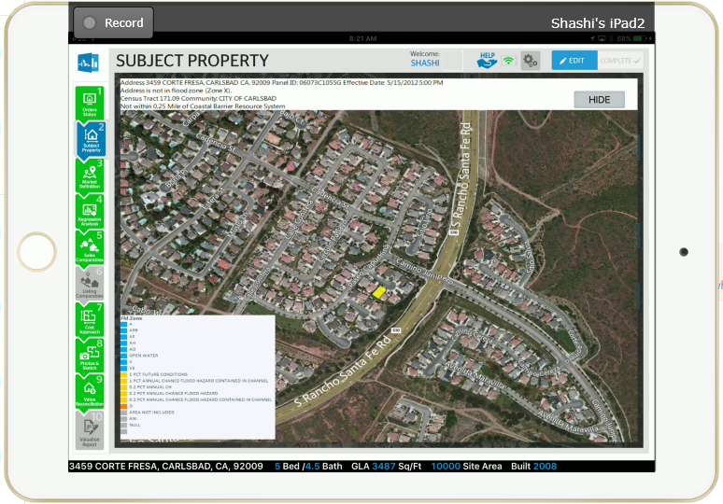
Subject property - flood map

Slide 16
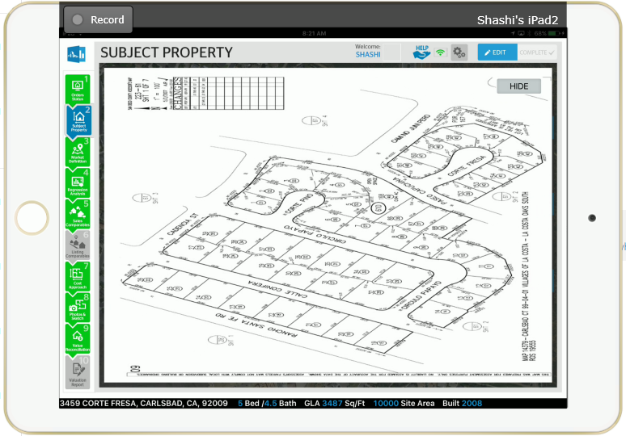
Subject property – plat map

Slide 17
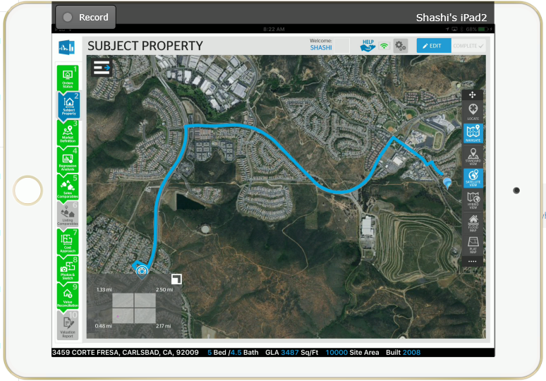
Subject property - navigation

Slide 18
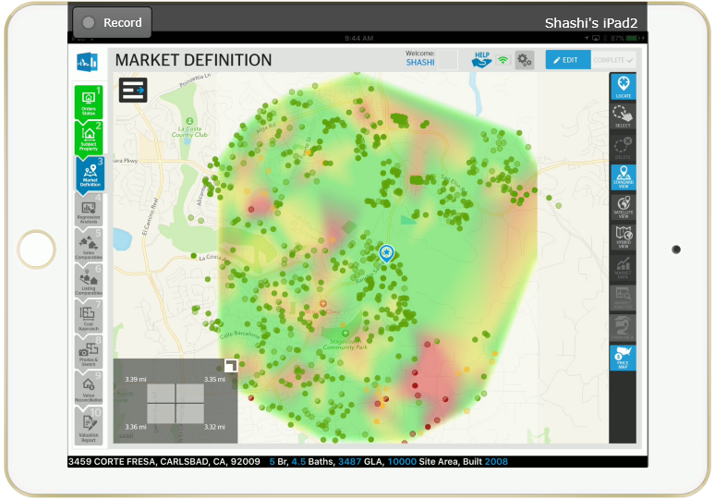
market definition – heat map
Mathematica!

Slide 19
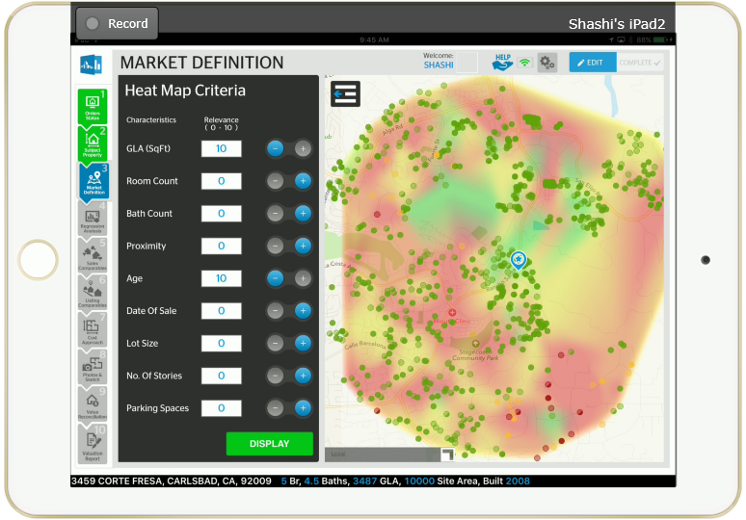
Heat map – impact of parameters
Mathematica!

Slide 20
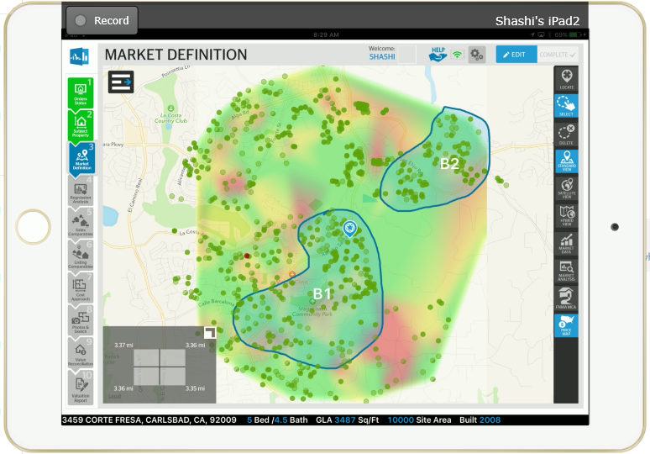
Market definition – user draws markets

Slide 21
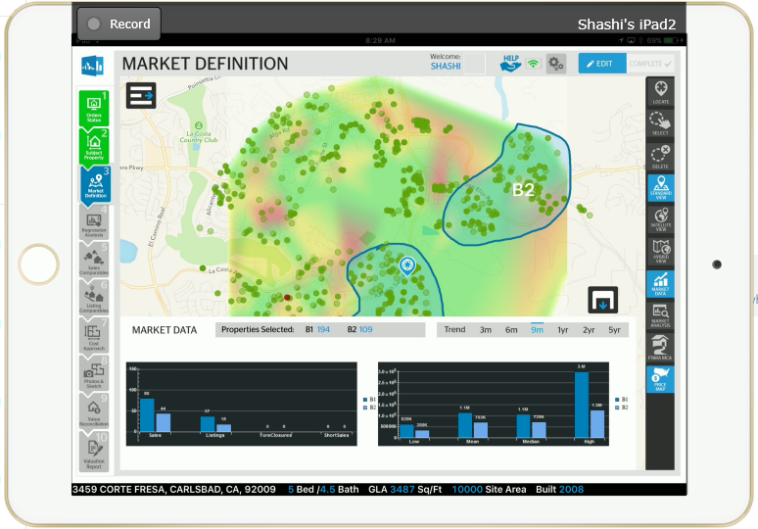
Market definition – user compares markets
Mathematica!

Slide 22
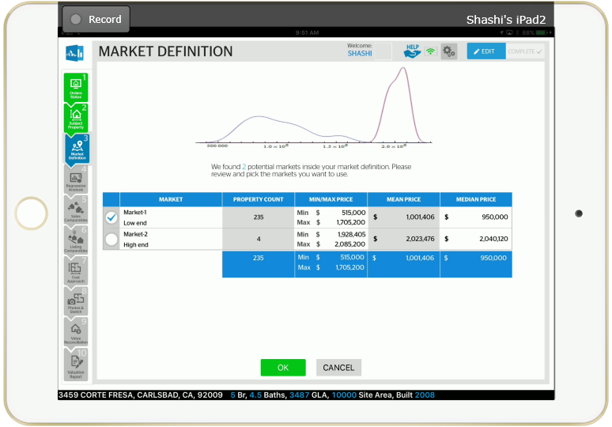
Market definition – submarkets in geographical markets
Mathematica!

Slide 23
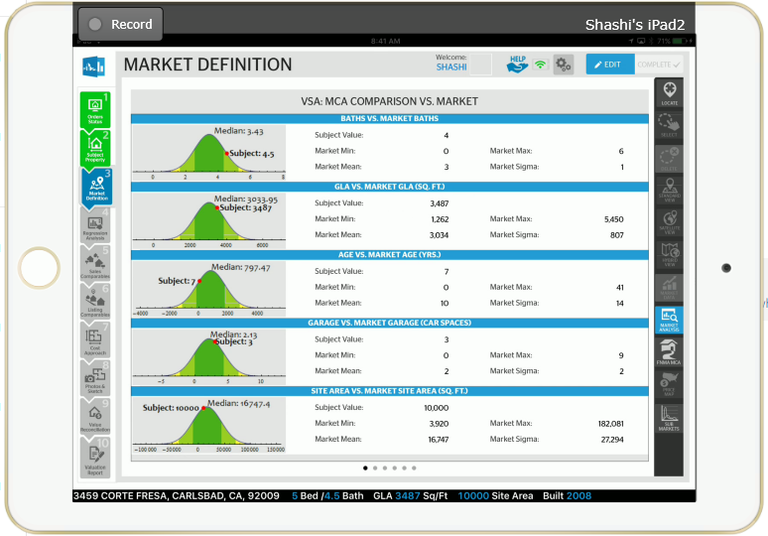
Market analysis
Mathematica!

Slide 24
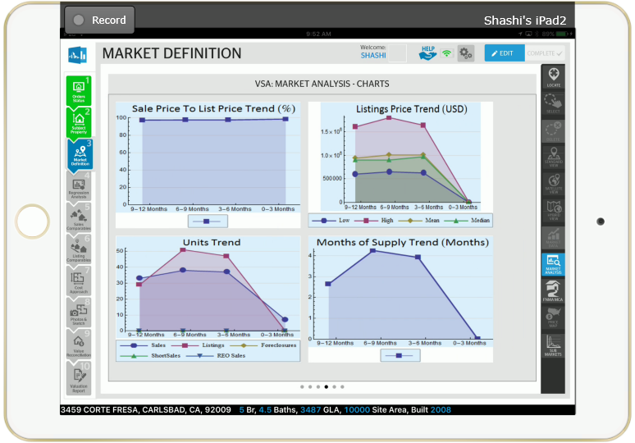
Market analysis – trend charts
Mathematica!

Slide 25
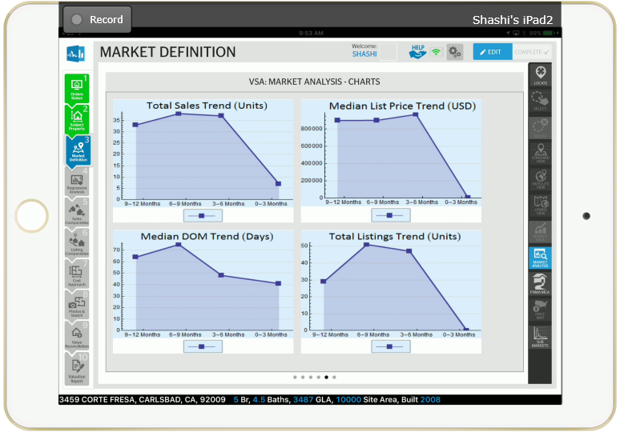
Market analysis – trend charts
Mathematica!

Slide 26
Valuation methods
MULTIPLE REGRESSION
SALES COMPARABLE
LISTINGS COMPARABLE
COST APPROACH
(RENT APPROACH)

Slide 27
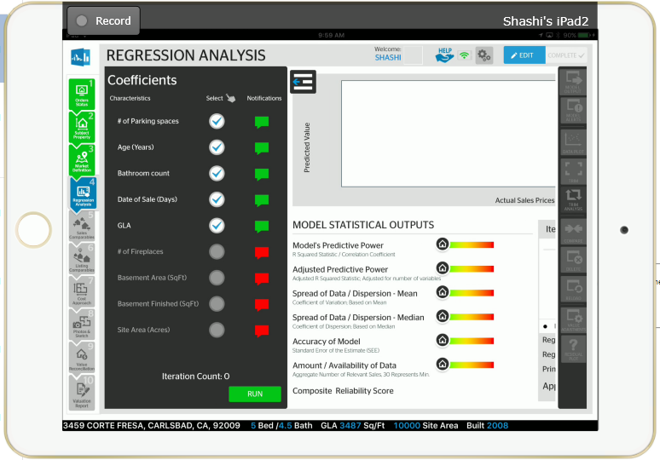
VALUATION METHODS – MULTIPLE REGRESSION
Mathematica!

Slide 28
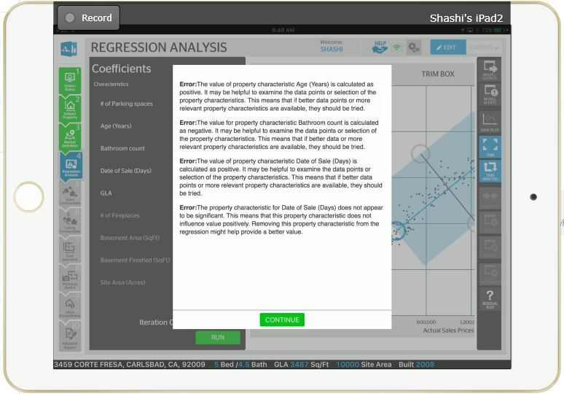
Regression analysis – first result - alerts
Mathematica!

Slide 29
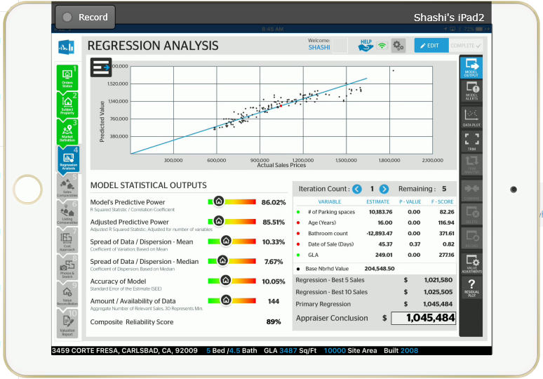
Regression analysis – model OUTPUT
Mathematica!

Slide 30
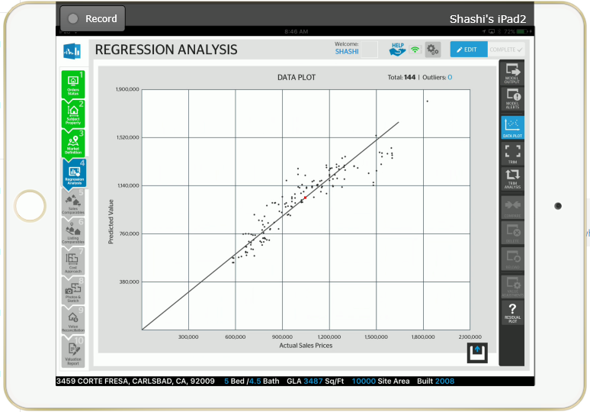
REGRESSION – DATA PLOT

Slide 31
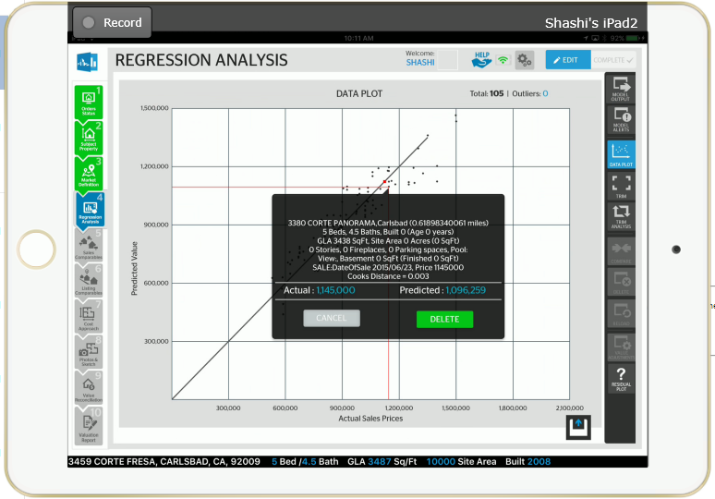
REGRESSION – DATA PLOT

Slide 32
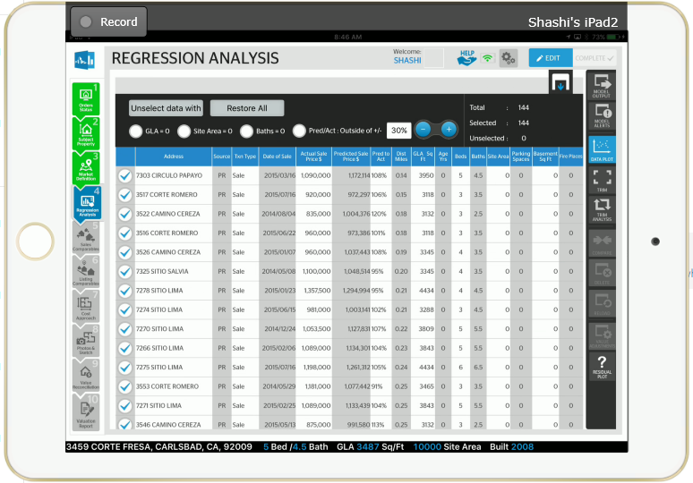
REGRESSION – DATA PLOT

Slide 33
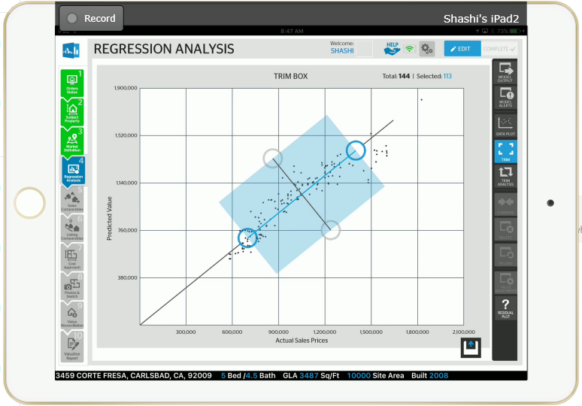
REGRESSION – TRIM BOX

Slide 34
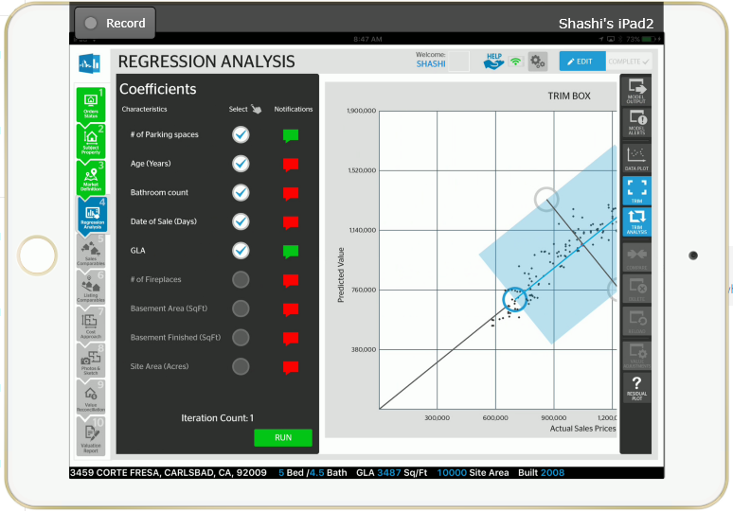
REGRESSION – MULTIPLE ITERATIONS

Slide 35
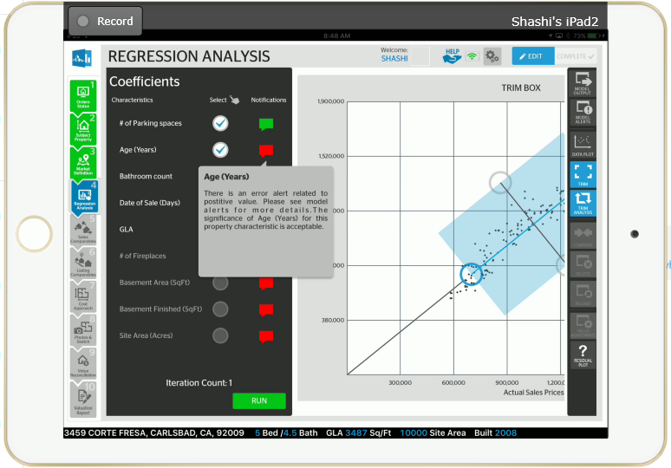
REGRESSION – PARAMETER ALERTS

Slide 36
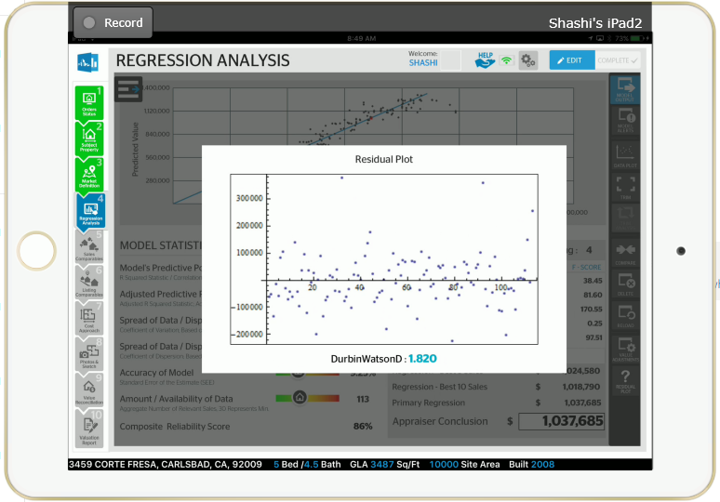
Mathematica!

Slide 37
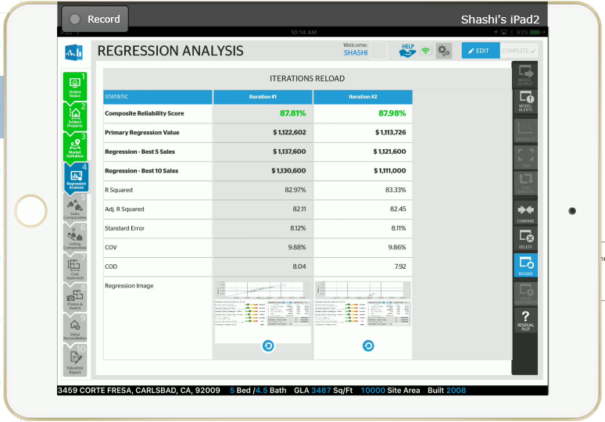
REGRESSION – RESTART /RELOAD

Slide 38
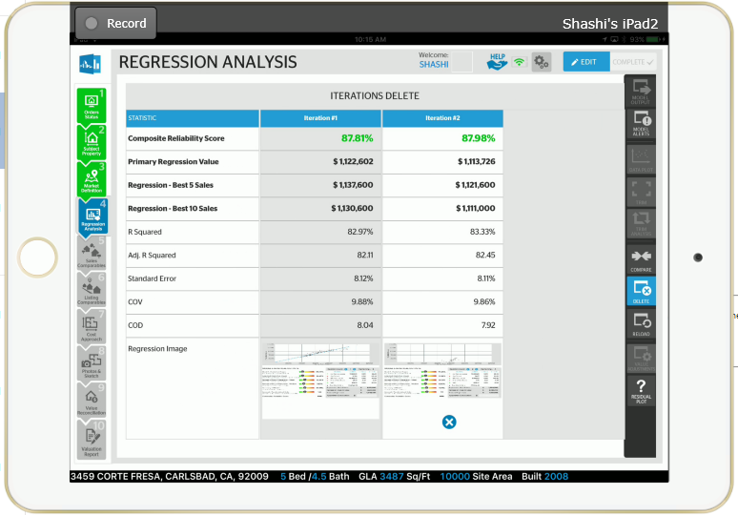
REGRESSION – DELETE ITERATION

Slide 39

REGRESSION – COMPARARE MODELS

Slide 40
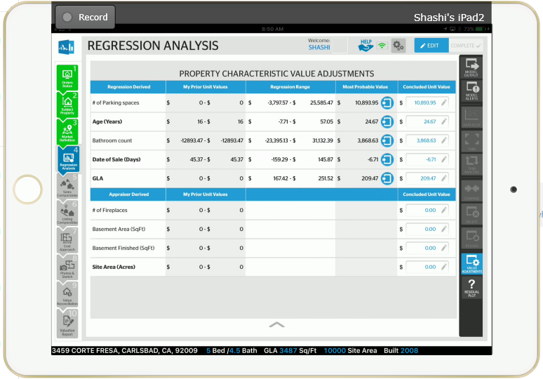
Regression – adopt A model

Slide 41
Regression analysis – model OUTPUT
Mathematica!

Slide 42
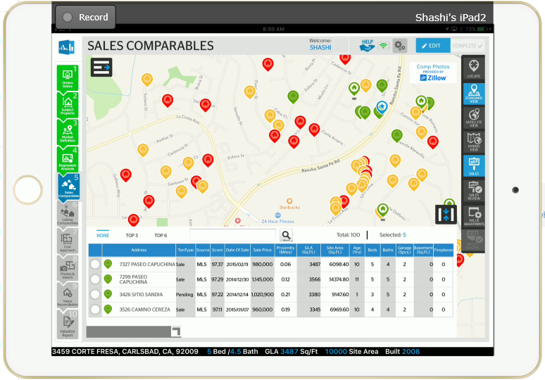
Valuation method – sales comparable

Slide 43
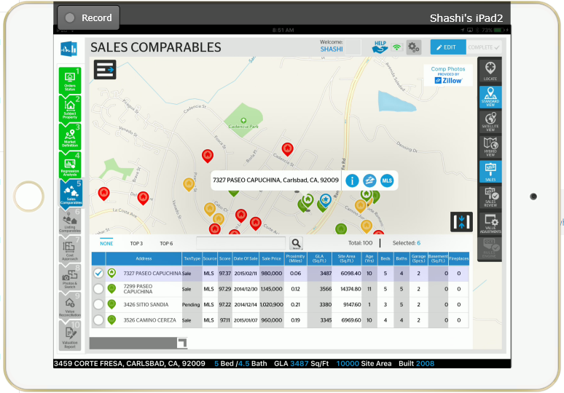
Comparables are ranked

Slide 44
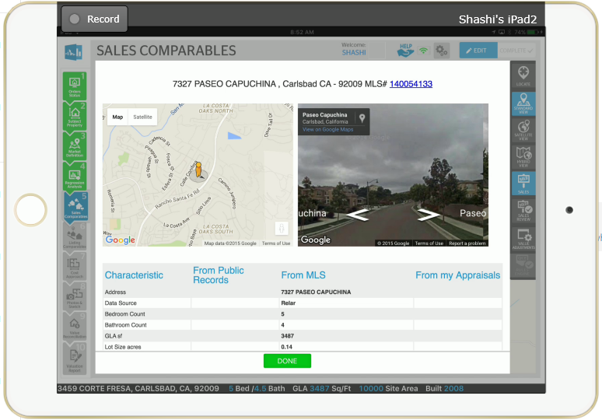
Comparable info/data

Slide 45
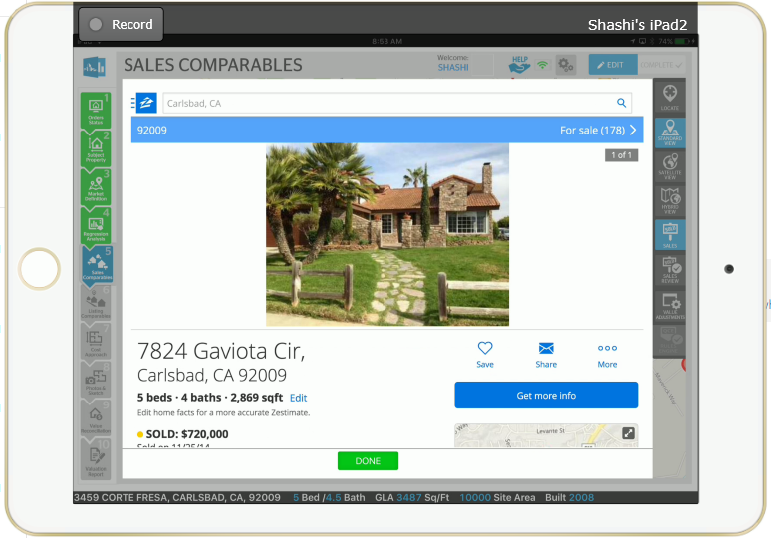
Comparable photos

Slide 46
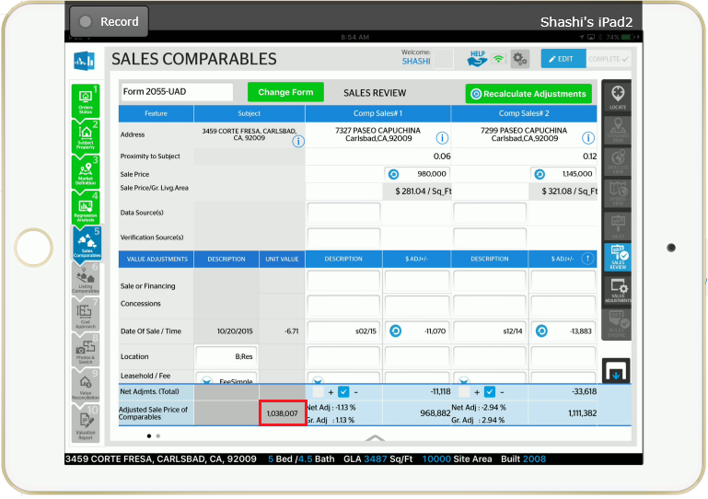
Valuation using sales comparables

Slide 47
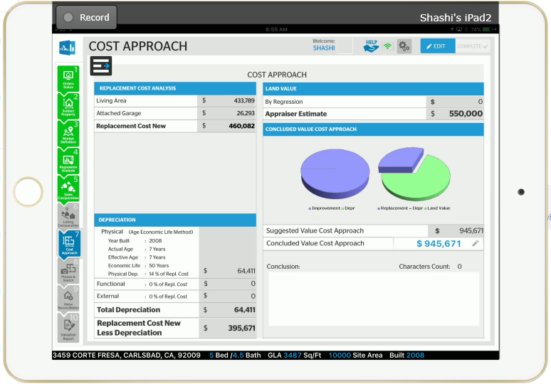
Valuation method - Cost approach
Mathematica!

Slide 48
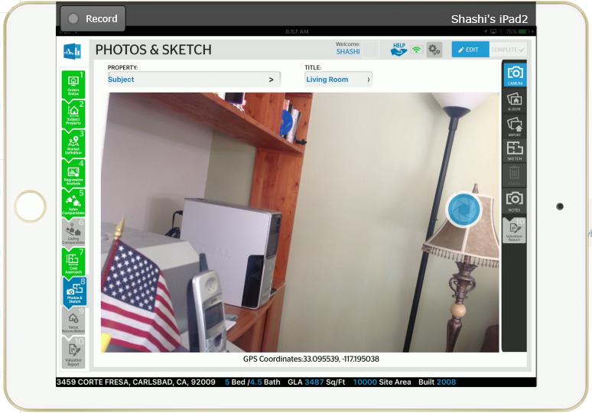
Photos for report

Slide 49
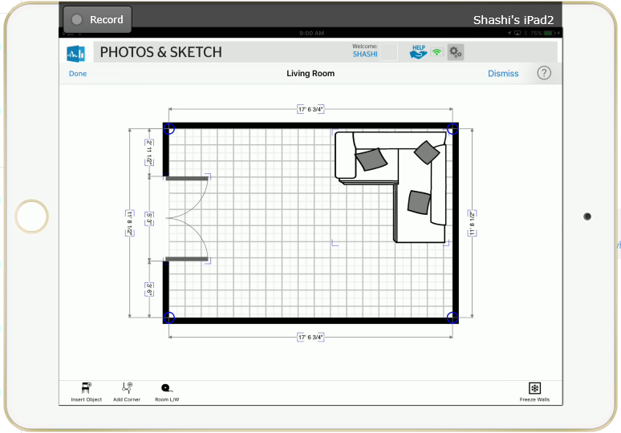
Make a sketch on site

Slide 50
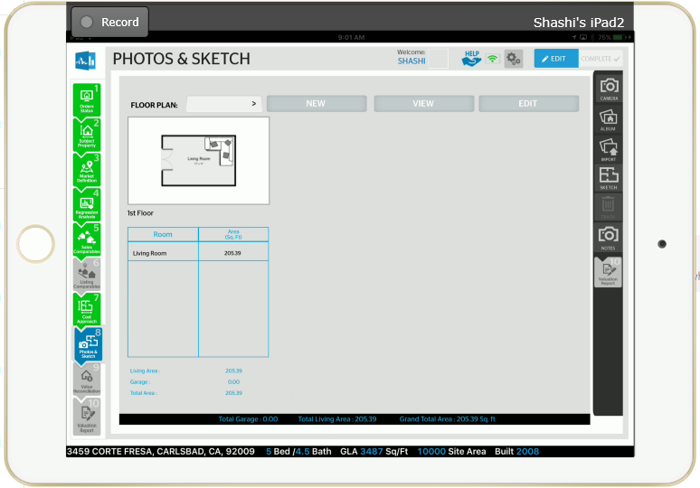
Multiple floors Sketching

Slide 51
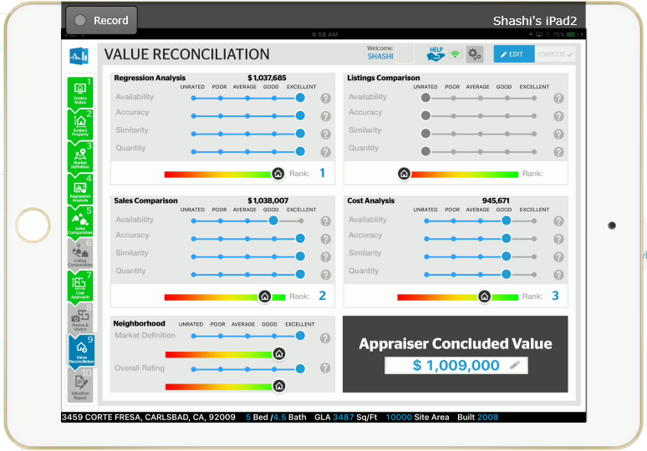
Final step – reconcile value using values from all four methods

Slide 52
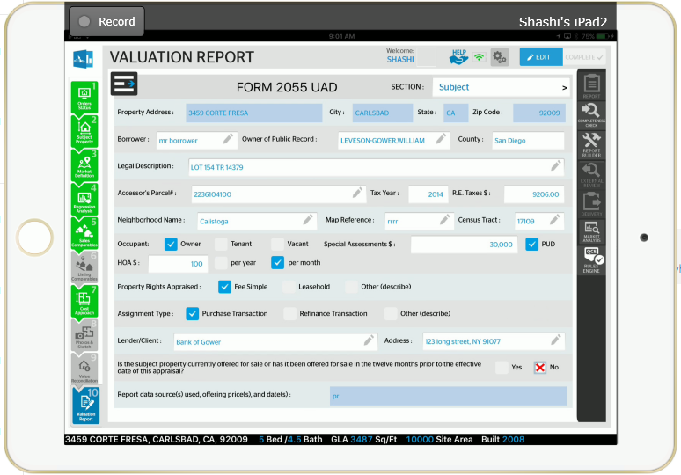
The usual form

Slide 53
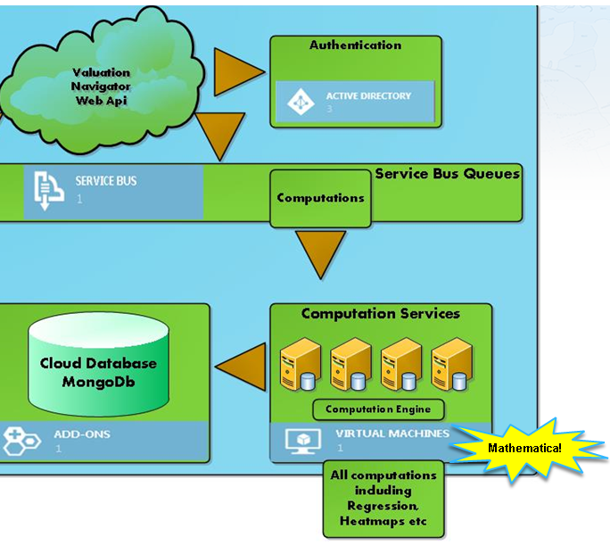
MATHEMATICA INTEGRATION

Slide 54
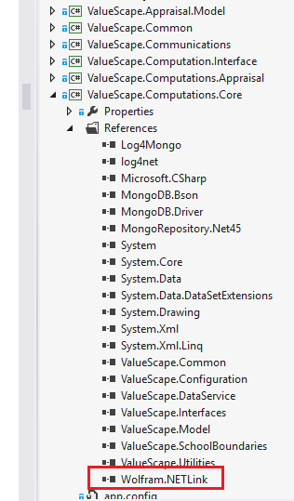
Add reference to link library

Slide 55
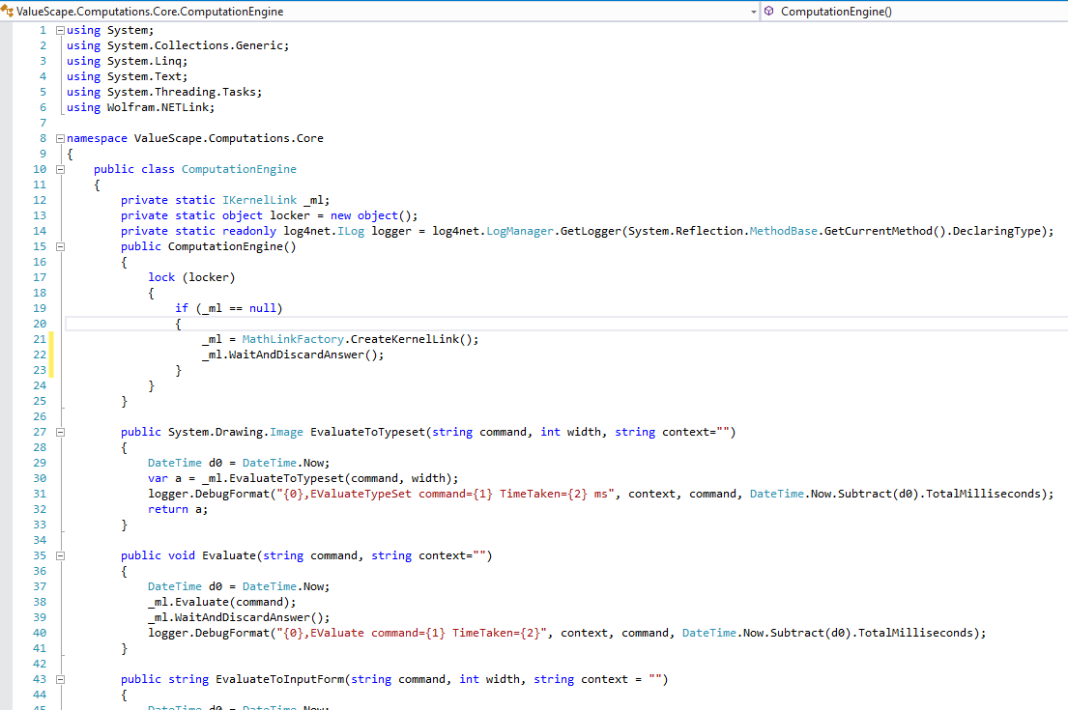
Encapsulate calls if you want to

Slide 56
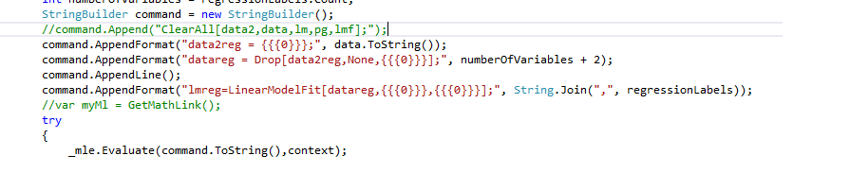
Pick your style
In-line calls

Slide 57
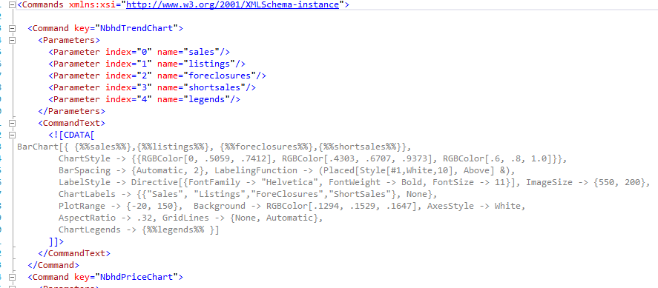
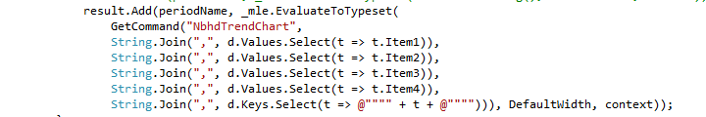
Decouple script
Put script in external file
And consume

Slide 58
Thank you for your time
We hope we have been successful in showing you how ValueScape is modifying the Appraisal Landscape and how Mathematica is helping with powerful tools to make that happen!

