Slide 1
The Universal Intraocular Lens Calculator: A Clinical Application of Mathematica
David Hjelmstad ^{1,2}
Samir I. Sayegh, MD, PhD, FACS ¹
¹The Eye Center, Champaign, IL
²Arizona State University

Slide 2
Disclosures
No financial disclosure relevant to this presentation.

Slide 3
Credits
Stephan Leibbrandt- Symbols and Numbers
Jessica Taibl- Eye Center, University of Illinois

Slide 4
Summary
Cataract, myopia, astigmatism “universal”
No current “universal” solution
We propose a solid approach
Mathematica’s central role in development
Web Mathematica potential central role in deployment
Suggestions are welcome
sayegh@umich.edu

Slide 5
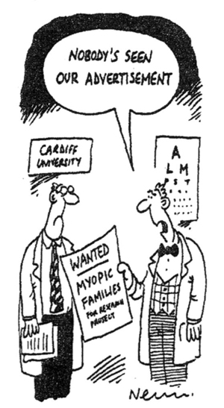

Slide 6
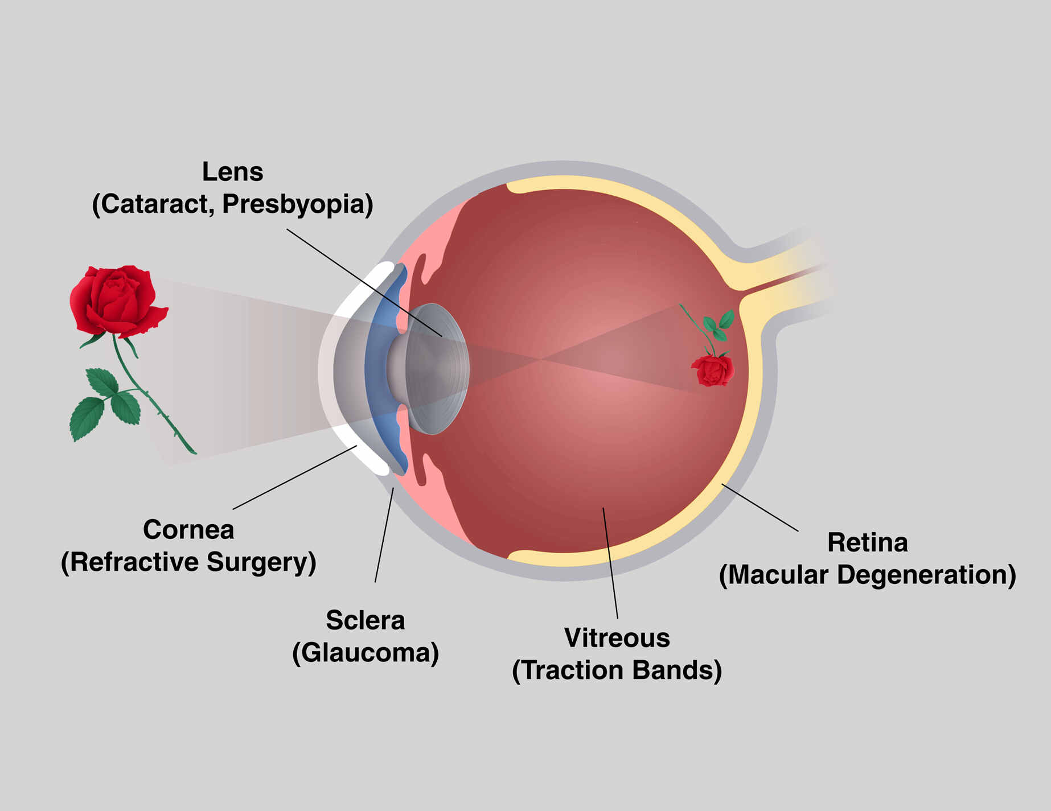
Applied Anatomy: The 2 mn-ophthalmologist

Slide 7
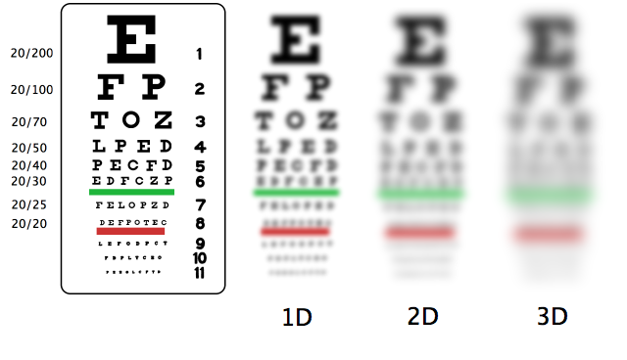

Slide 8
5 THINGS TO SEE ***
1)Transparency
2) Bend/Focus
3) Detector Retina
4) Transmission to
5) Brain

Slide 9
From Cradle to Grave
Laser/injection
CE IOL
TORIC?
AMD
35%
Congenital
Cataract
100%
Laser
Diabetes
Bifocals
35%
Glaucoma
Glasses
LASIK
10%
Presbyopia
100%
MYOPIA ASTIGMATISM HYPEROPIA
35%
STRABISMUS/AMBLYOPIA (crossed eye/lazy eye) 2%
0
10
20
30
40
50
60
70
80
90

Slide 10
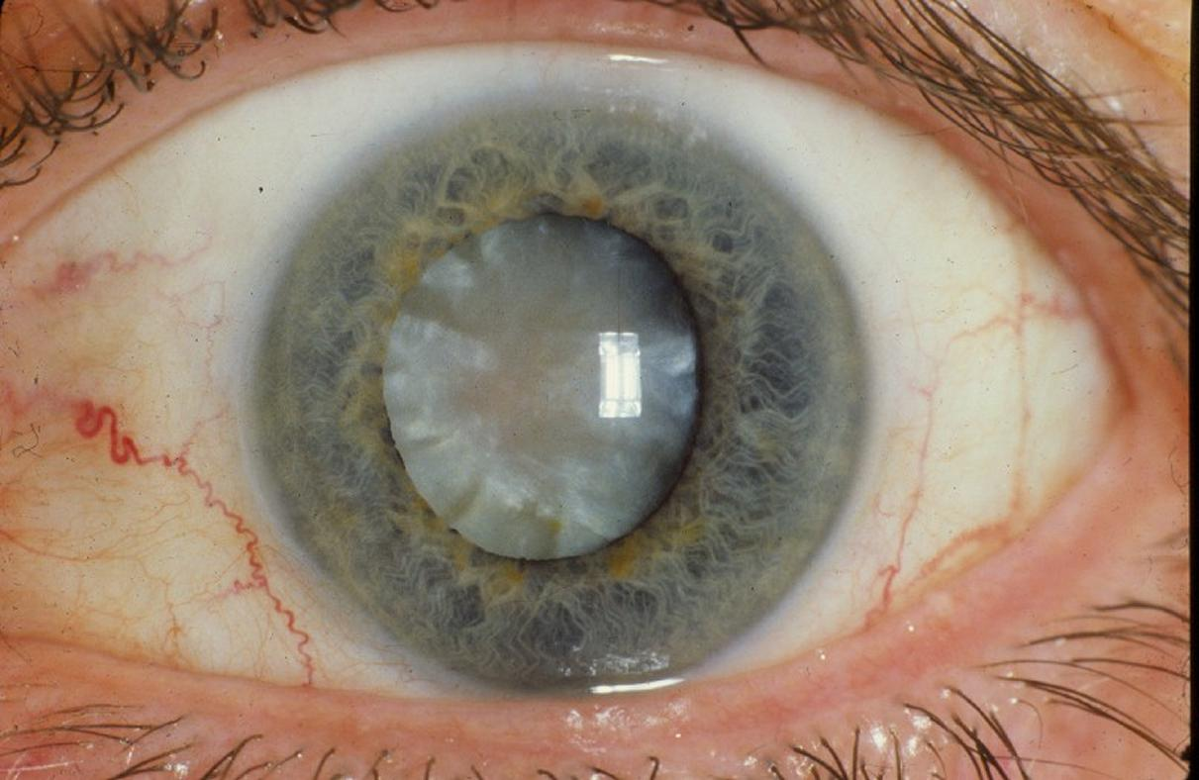

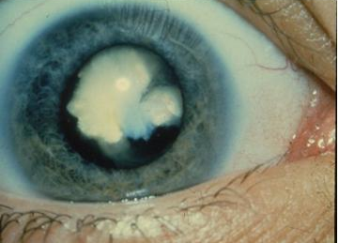
Cataracts

Slide 11
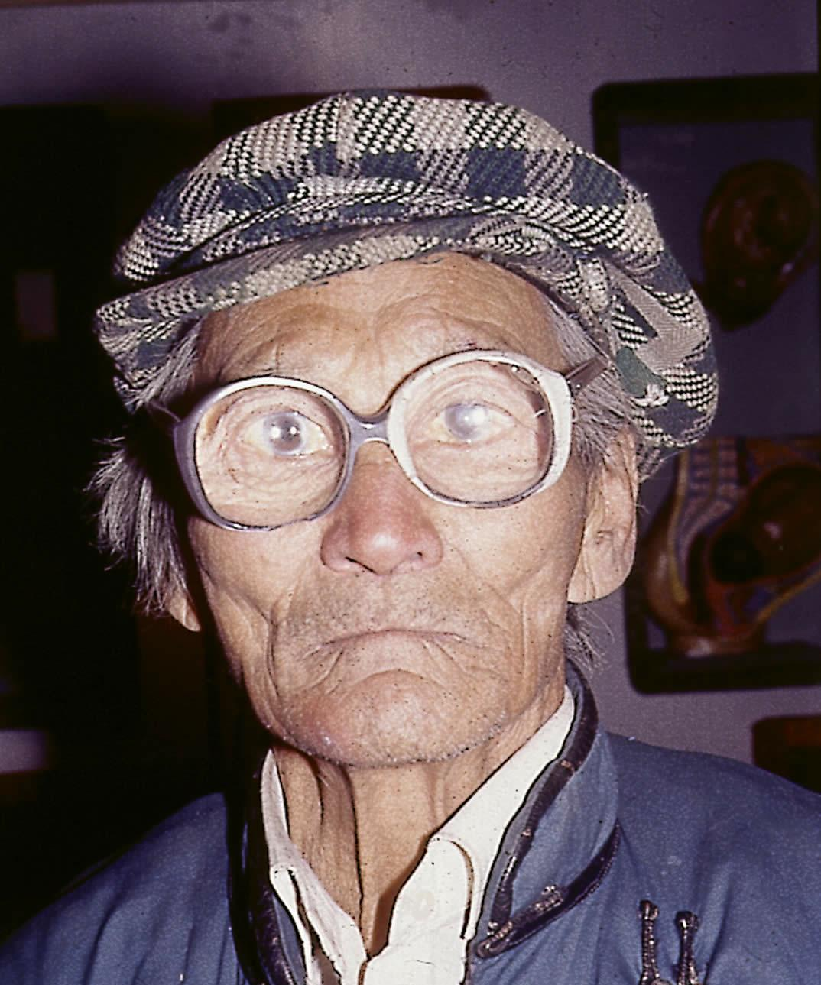
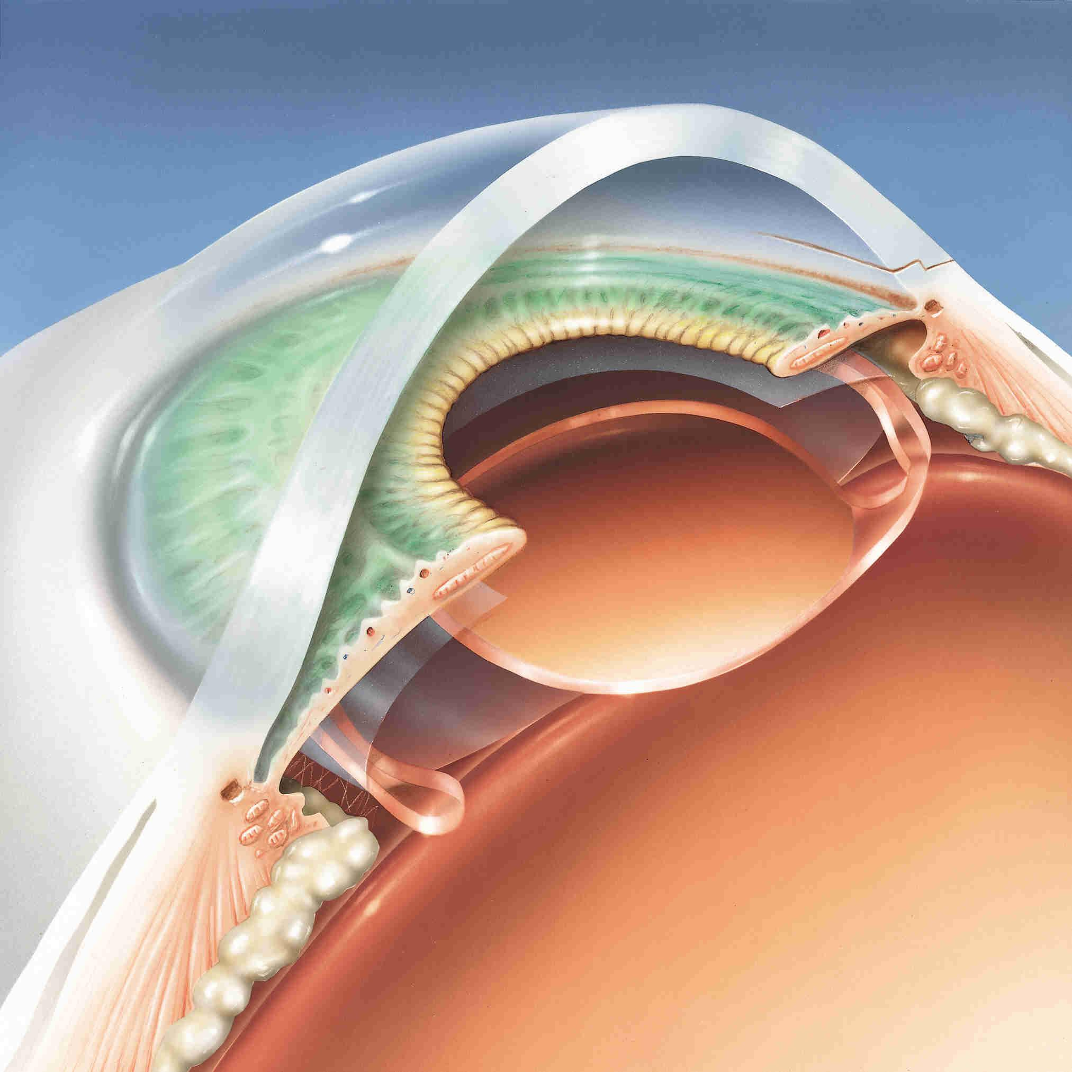
Cataracts
Cataract cured by removal of clouded natural lens
Removing natural lens reduces optical power of eye system by about 1/3. Two options for correction:
  Extremely thick spectacles
  Implant a man-made lens where the natural lens used to be.

Slide 12
GOALS of METHOD
Conceptual simplification
Systematic IOL power calculation
IOL power error analysis
IOL design and refractive procedure planning
Power/Analysis/Design of toric IOL
Will illustrate a few aspects
Email for more details/collaboration

Slide 13
On the shoulders of Giants
20
Hjelmstad/Sayegh
OCT
19.5
Fyodorov IOL formula
Colliac
Ridley- First IOL
19
Legrand/others
18.5
Sampson
Von Helmholz
Ophthalmoscope
18
Gauss

Slide 14
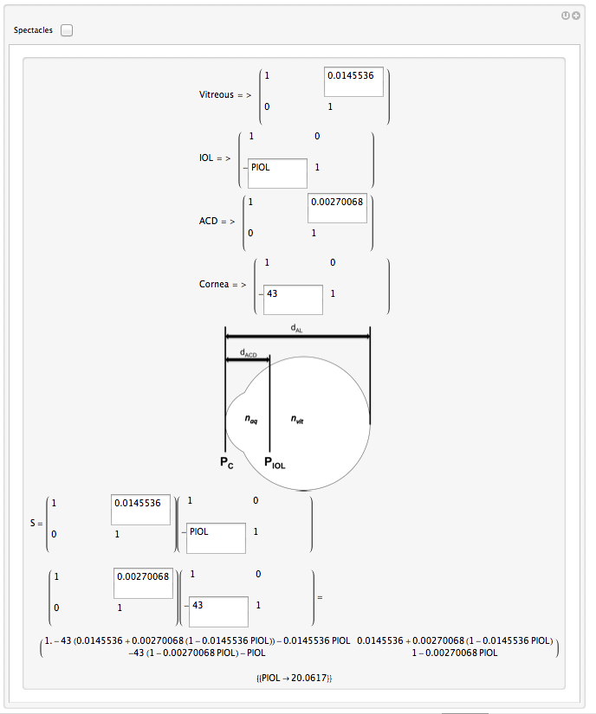
Our interactive matrix calculator
Numeric

Slide 15
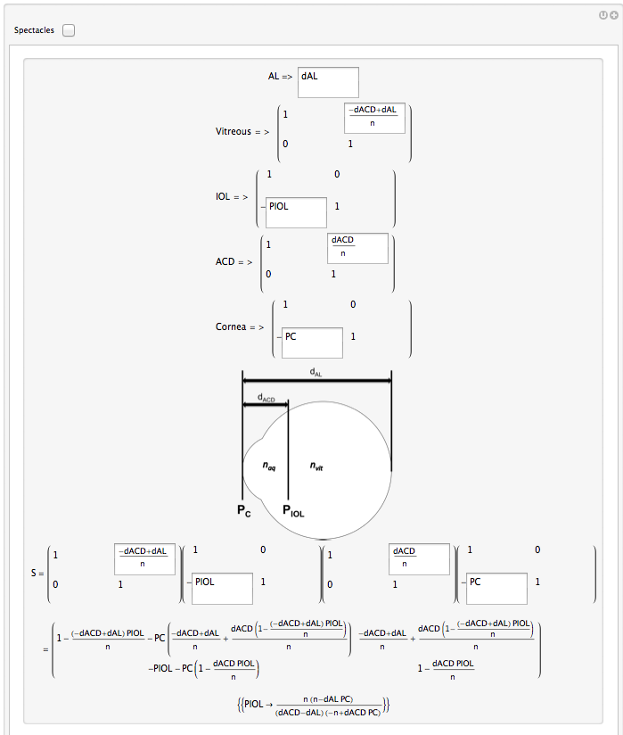
Our interactive matrix calculator
Symbolic

Slide 16
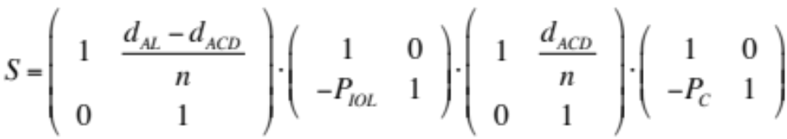
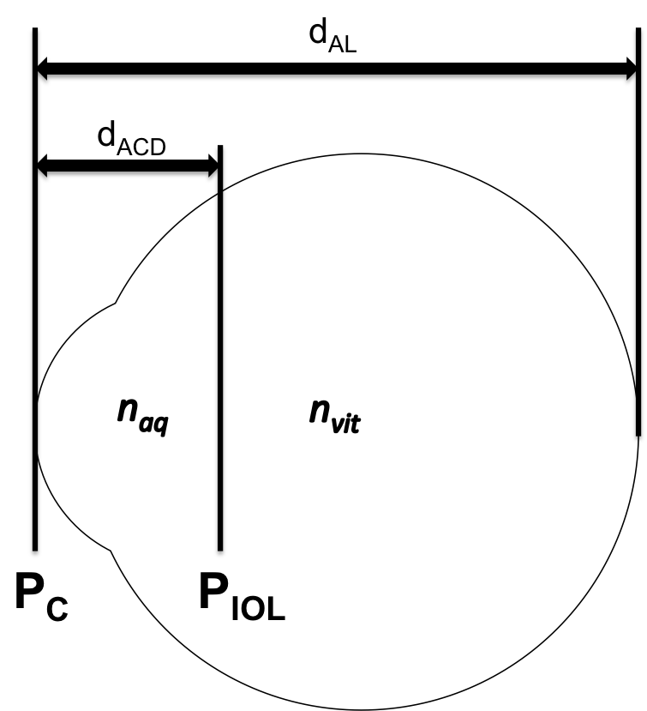
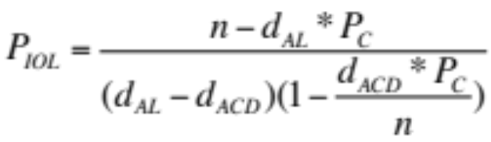
Fyodorov 1967
(Mother IOL formula)
Apply emmetropia condition, S₁₁ = 0:

Slide 17
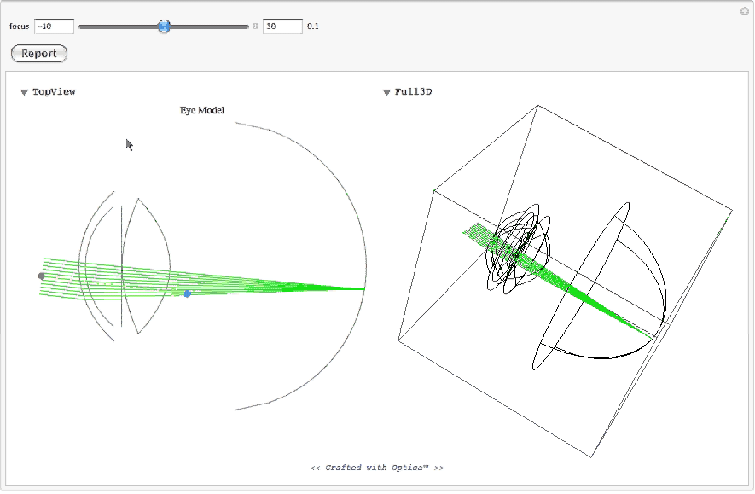
Prior work with Don Barnhart

Slide 18
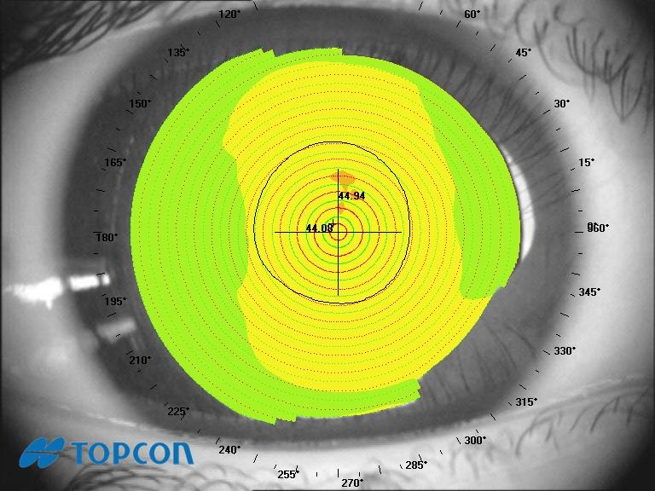
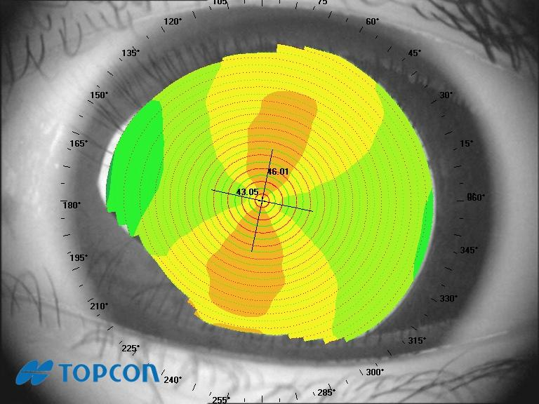
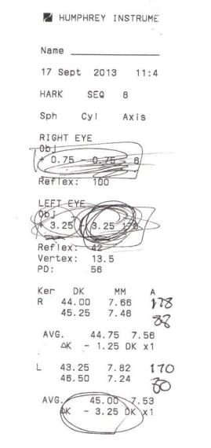
Astigmatism

Slide 19


Astigmatism Illustrated

Slide 20
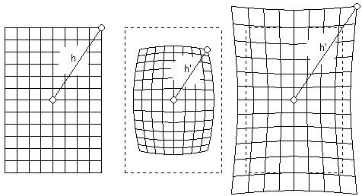
Visual Perception

Slide 21
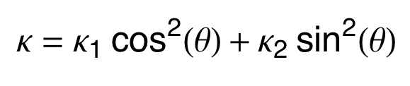
Euler Curvature Formula
The curvature of a surface satisfies
where κ is the normal curvature in a direction making an angle theta with the first principal direction and κ₁ and κ₂ are the principal curvatures.
Weisstein, Eric W. "Euler Curvature Formula." From MathWorld--A Wolfram Web Resource. http://mathworld.wolfram.com/EulerCurvatureFormula.html

Slide 22
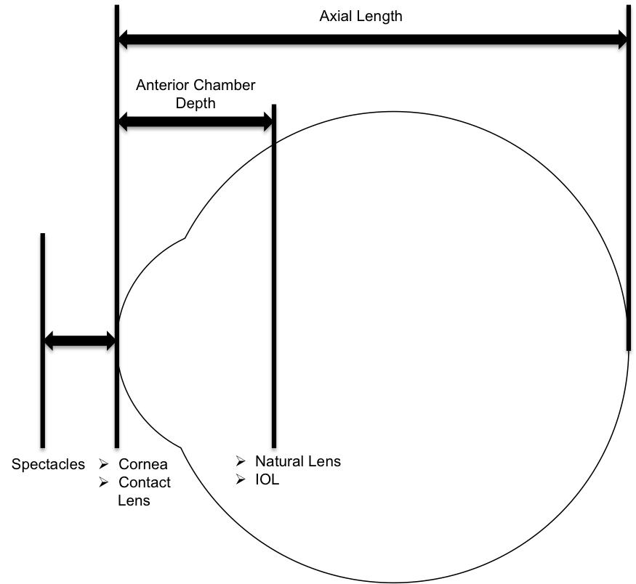
How to fix it
The astigmatism in the cornea and the natural lens combine
An aspherical lens may be introduced in the system in such a way as to "cancel out" this net astigmatism

Slide 23
Astigmatism and Cataract Surgery
When natural lens is removed, the only possible source of astigmatism left is the cornea
Cornea directly accessible for measurement
  Corneal Topography: measures power and orientation of the principle planes
  By Euler's formula, these will always be perpendicular
  To correct astigmatism with an IOL, need an aspherical lens with principal plane powers that will cancel astigmatism, and need to know the orientation to implant the lens.

Slide 24
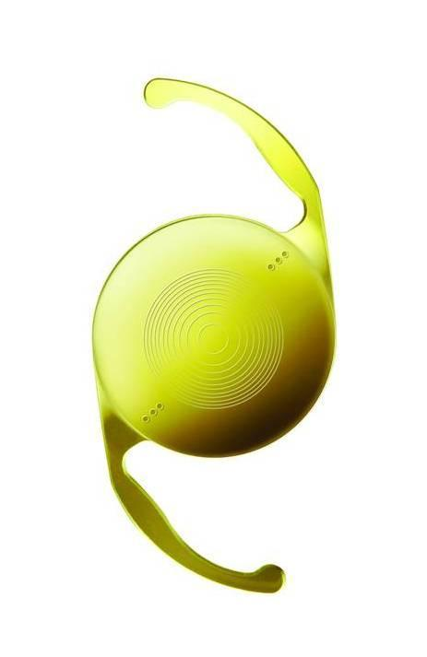
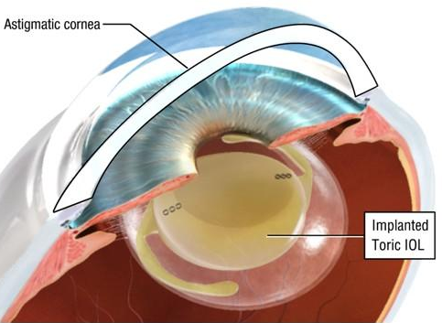
Toric IOL

Slide 25
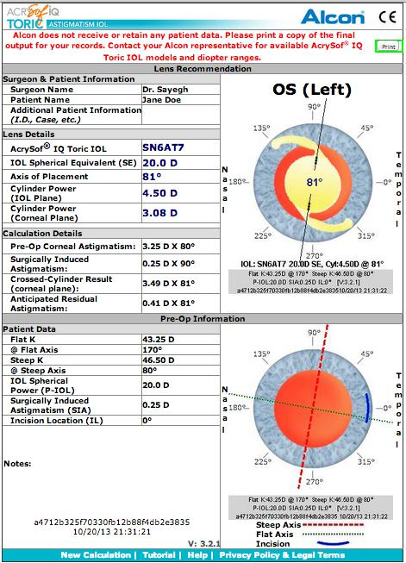
Toric IOL power calculation

Slide 26
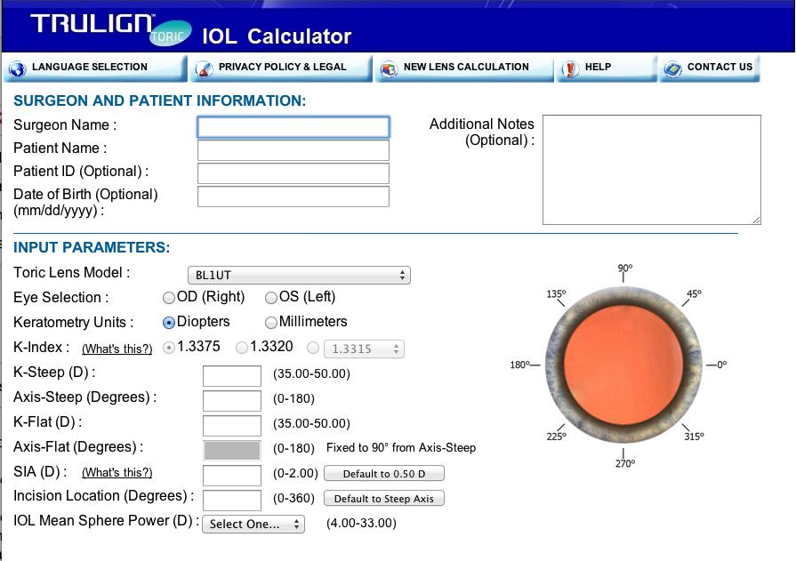
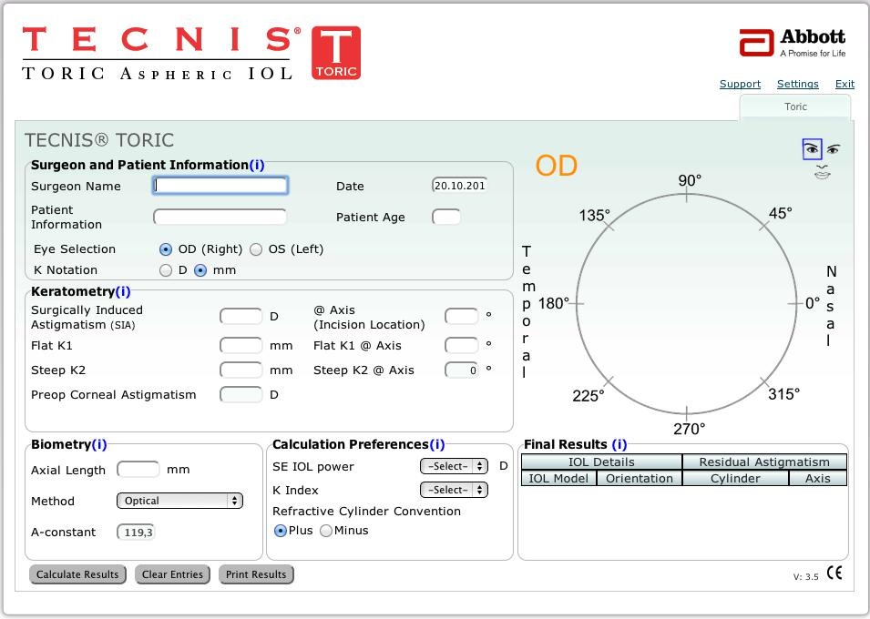
Manufacturers/Websites
Currently 3 manufacturers FDA approved in the US:
  Alcon
  Tecnis (2013)
  Bausch & Lomb (2013)

Slide 27
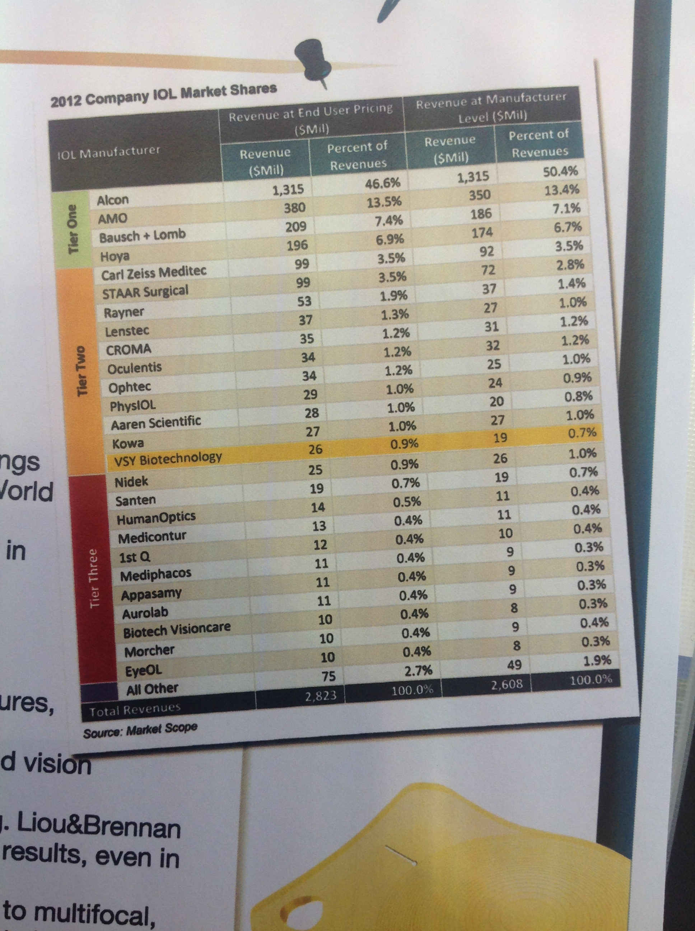
Many more “elsewhere”

Slide 28
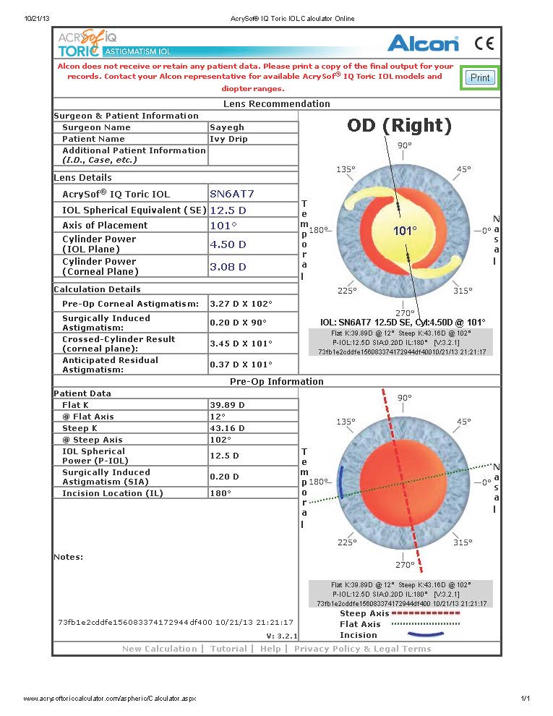

Slide 29
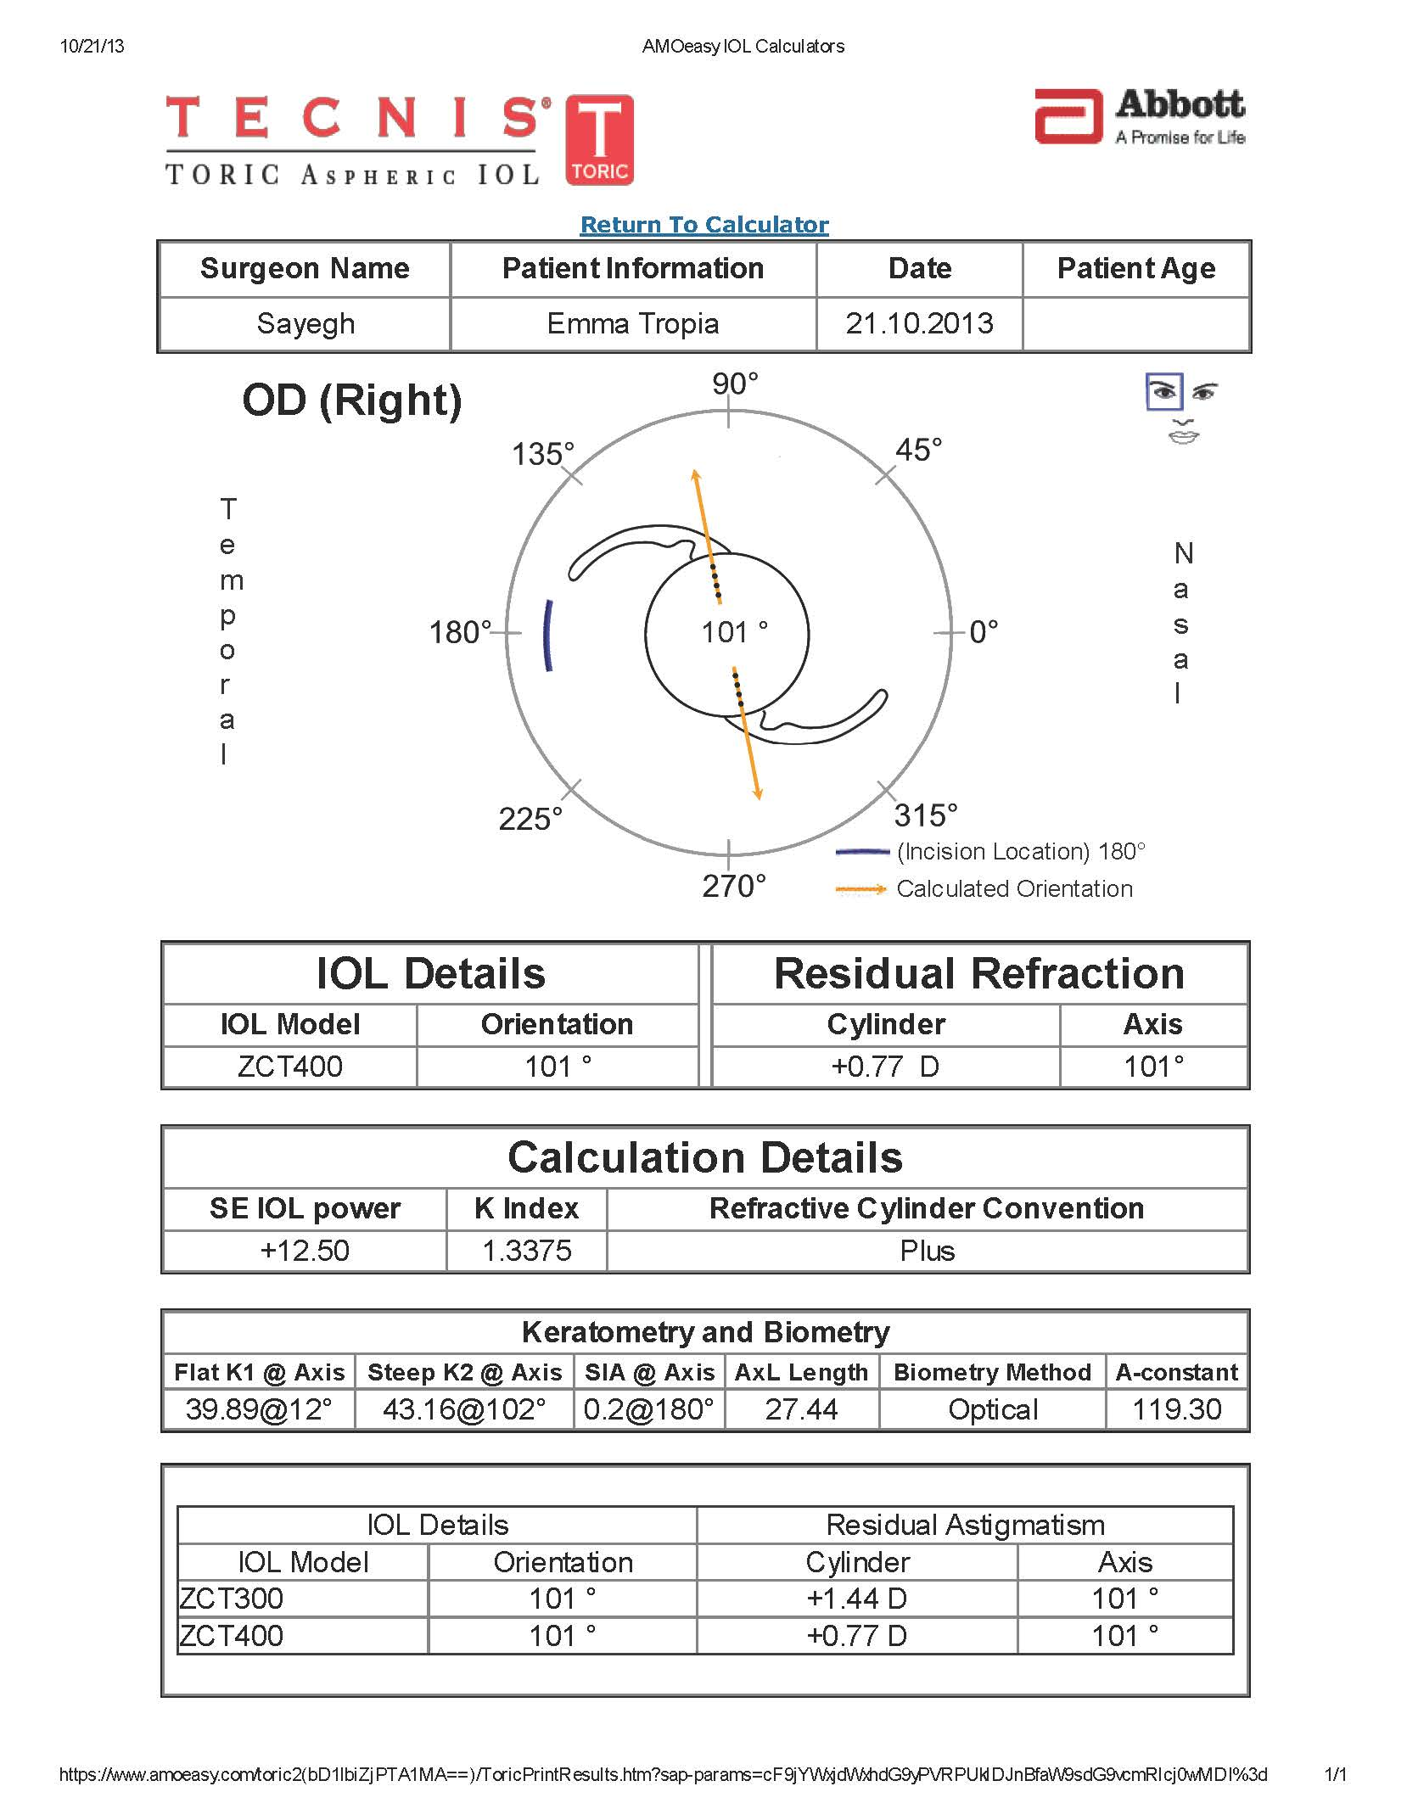

Slide 30
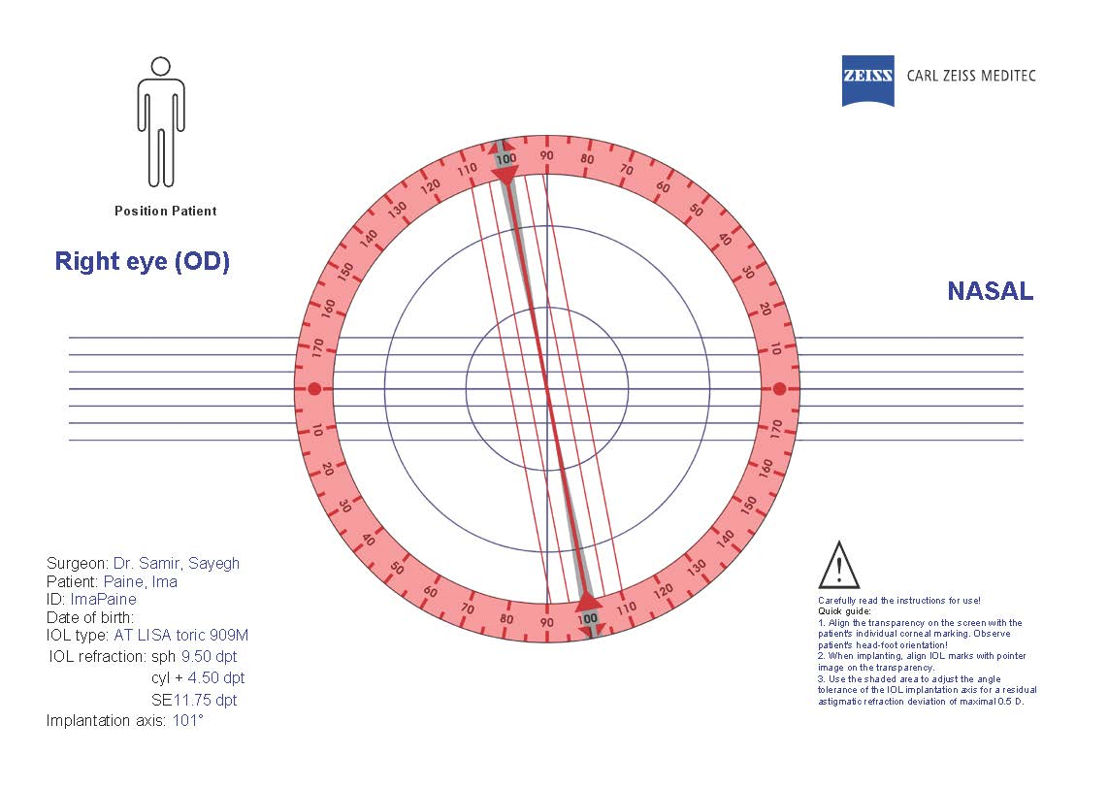

Slide 31
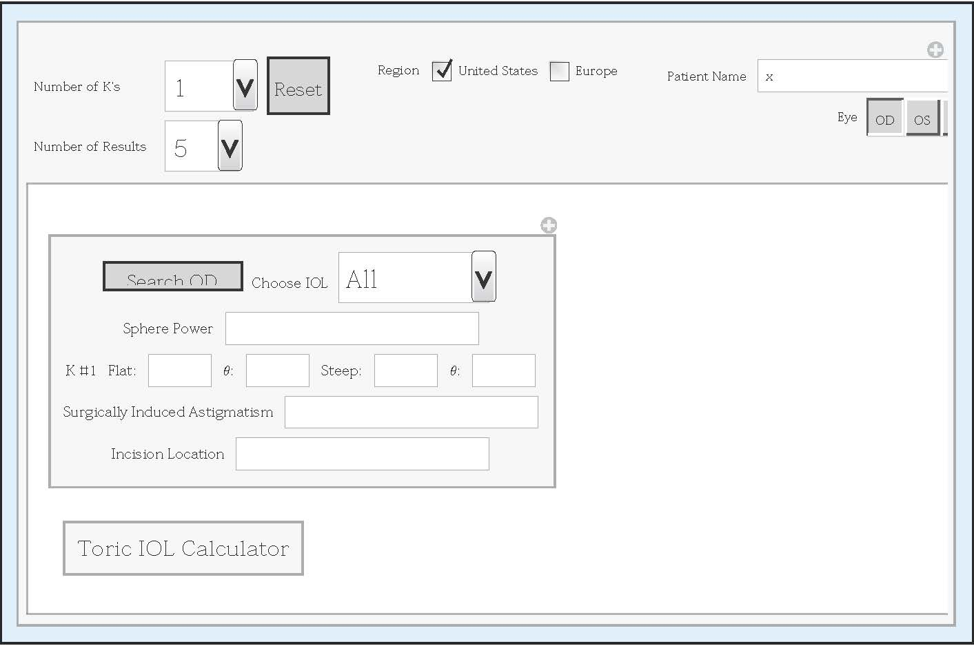
UICT Lite (Mathematica) Interface

Slide 32
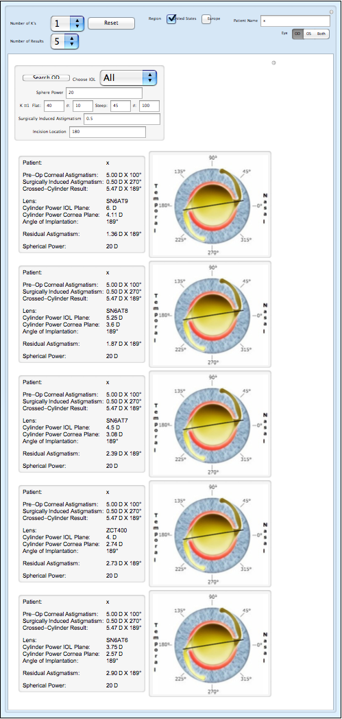
UICT Lite Output

Slide 33
UICT (“wicked”?)
Advantages
  Does exact calculation
  Choice of 2 stage calculation or 1 stage
  Provide all FDA or CE approved choices
  Provides additional tools, such as LRI, toric contact lens option for patient who wants to wait for cataract but correct for astigmatism
  Visual interface to suggest "what if"
  Evolving towards “universal expert system for cataract and refractive surgery”

Slide 34
Summary
Cataract, myopia, astigmatism “universal”
No current “universal” solution
We propose a solid approach
Mathematica’s central role in development
Web Mathematica potential central role in deployment
Suggestions are welcome
Thanks you!

