Slide 1
Modeling Public Pensions with Mathematica and Python II
Brian Drawert, PhD
UC Santa Barbara & AppScale Systems, Inc
Sponsored by
Novim & Laura and John Arnold Foundation

Slide 2
Pension Calculation:
From Mathematica to the Cloud
Mathematica model to cloud app
Cloud Computing
Developing a Pension Calculator-as-a-service
Demo of the Pension calculator

Slide 3

From Mathematica to the Cloud
Publicly accessible platform
  Web app built on Google App Engine / AppScale
  Pension Computation model in Mathematica
First attempt: Appscale to Web Mathematica
  Limited ability to scale up / down
Solution: rewrite engine in Python

Slide 4
Pythonika
Evaluate Python code from within a Mathematica Notebook
  MathLink module
  Automatically translates all basic data types
  Define Mathematica functions with Python code
Open Source
  http://code.google.com/p/pythonika
  http://github.com/briandrawert/pythonika

Slide 5
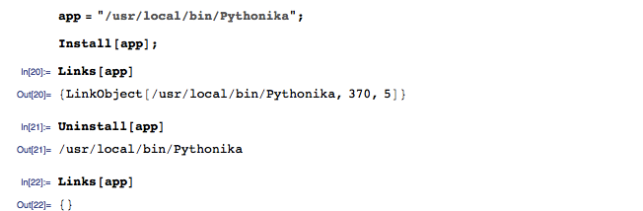
Connect to Pythonika

Slide 6
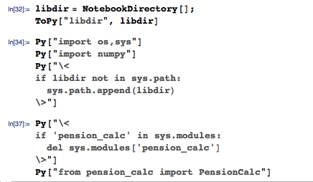
Setup Pythonika

Slide 7
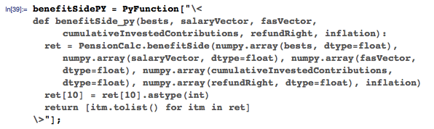
Pythonika function

Slide 8
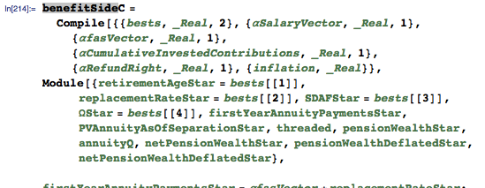
Mathematica function

Slide 9
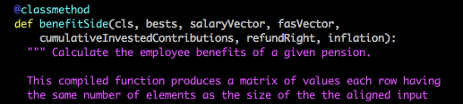
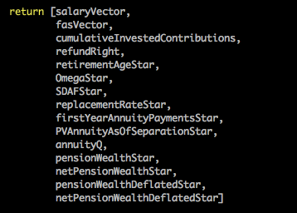
Complex data structures preserved

Slide 10
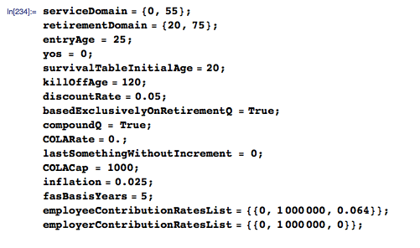
Identical parameters

Slide 11
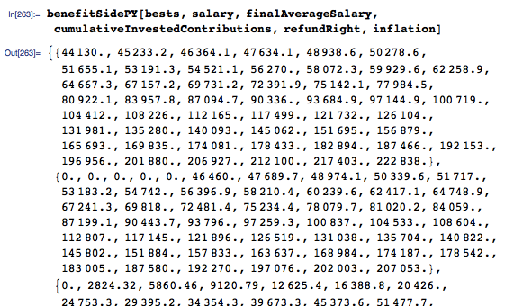
Run Python

Slide 12
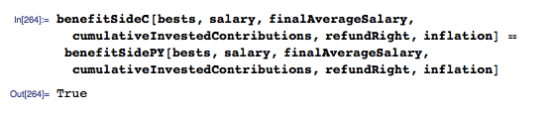
Unit Test

Slide 13
Robust Collaboration
Pythonika unit tests allowed our team to efficiently work together
  Mathematica used to develop and validate models
  Python used for the web app
  Multiple development iterations, accounting for additional pension plans with new complexities
50+ functions converted
2000+ lines of code in the Python library

Slide 14
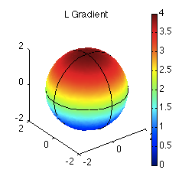
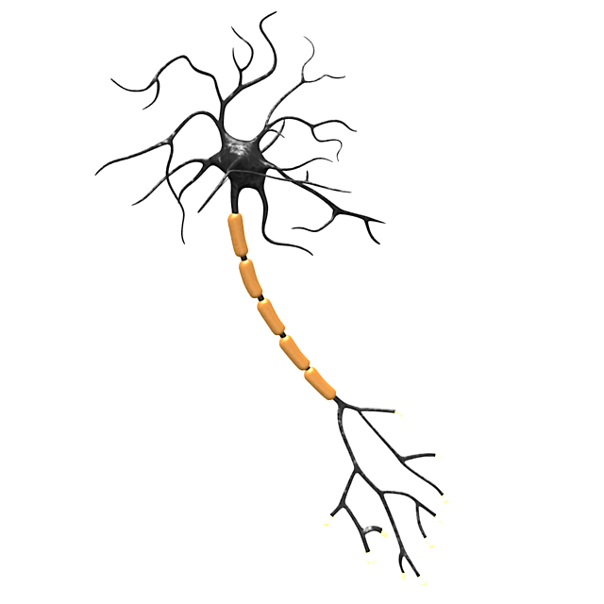
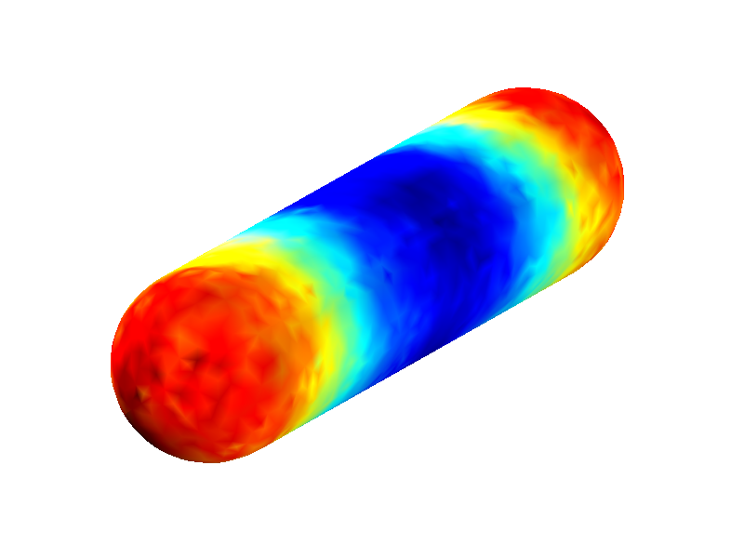
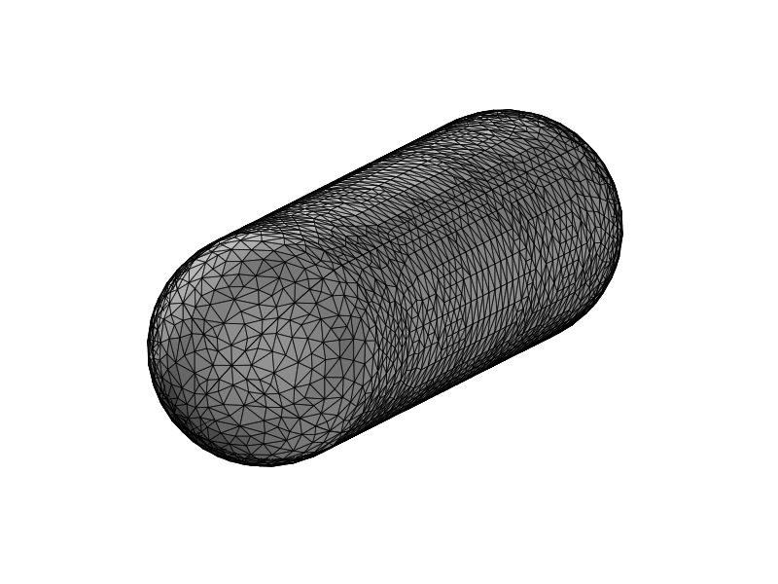
Other Advantages of Pythonika
Enhance your Mathematica with Python specific software
  PyURDME: Spatial stochastic simulation of bio-chemical systems
Drawert et al., BMC Systems Biology (2012)

Slide 15
Cloud Computing
What is Cloud Computing?
  Resources acquired on-demand and self-service
  Resources are pooled across multiple customers
  Rapid elasticity: scale up and scale down
  Metered service: pay for what you use

Slide 16
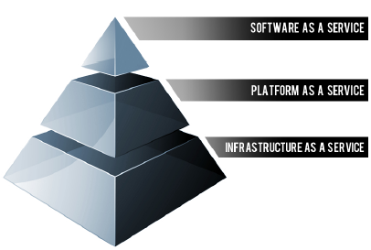
Cloud Computing
Image courtesy: Rackspace.com

Slide 17
IaaS : Infrastructure-as-a-service
Cloud Computing infrastructure
  Servers, storage, network and operating systems as an on-demand service
Public cloud service providers
  Amazon EC2, Microsoft Azure, Rackspace, Google Compute Engine
Private cloud: IaaS on your own hardware
  OpenStack, Eucalyptus, CloudStack

Slide 18
SaaS : Software-as-a-service
On-demand software designed for end users
  Delivered over the web
  Centrally managed: no install, no upgrades
  Metered: Subscriptions or pay-as-you-go
Salesforce, Google Gmail/Docs, Adobe Creative Cloud, Microsoft Office 365

Slide 19
PaaS : Platform-as-a-service
Platform for web application development
  Rapid development and deployment
  Abstracts away infrastructure complexity
  Scalability, load balancing and failover
Public: Google App Engine, Heroku, Microsoft Azure
Private: AppScale, OpenShift

Slide 20

Google App Engine
PaaS: run web apps on Google’s cloud infrastructure
  Pay for what you use: CPU, storage, bandwidth
  Automatic scaling and load balancing
  Many useful services
    User auth, Data store, Background task queue
  Languages: Python, Java (Go, PHP experimental)

Slide 21

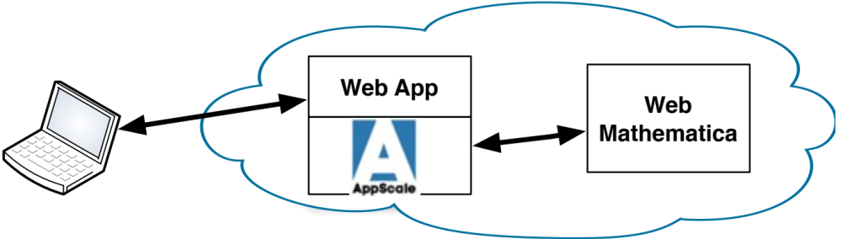
AppScale
Private PaaS: run GAE apps on any public/private cloud infrastructure
Open Source: Can be customized
  Cython: optimized static compiler for Python Pension calculation: Python 27ms, Cython 15ms (COLAmatrix)
  Integrate with Web Mathematica

Slide 22
Pension Calculator as-a-service
Service to enable plan members and plan managers to analyze plan costs and benefits.
Democratizing the ability to analyze and evaluate complex pension issues
Novim: non-profit, non-advocacy
  Not taking sides, no value judgments
  Providing tools for informed discourse

Slide 23
Pension Calculator as-a-service
UI for intuitive manipulation of pension parameters
  without overwhelming users with complexity
Widely accessible web interface for public use
  Mathematica package for researchers
  Open API for researcher web development

Slide 24
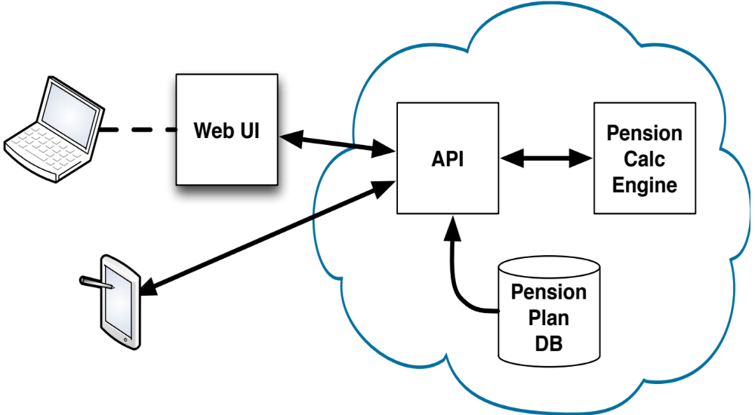
Pension Calculator as-a-service

Slide 25
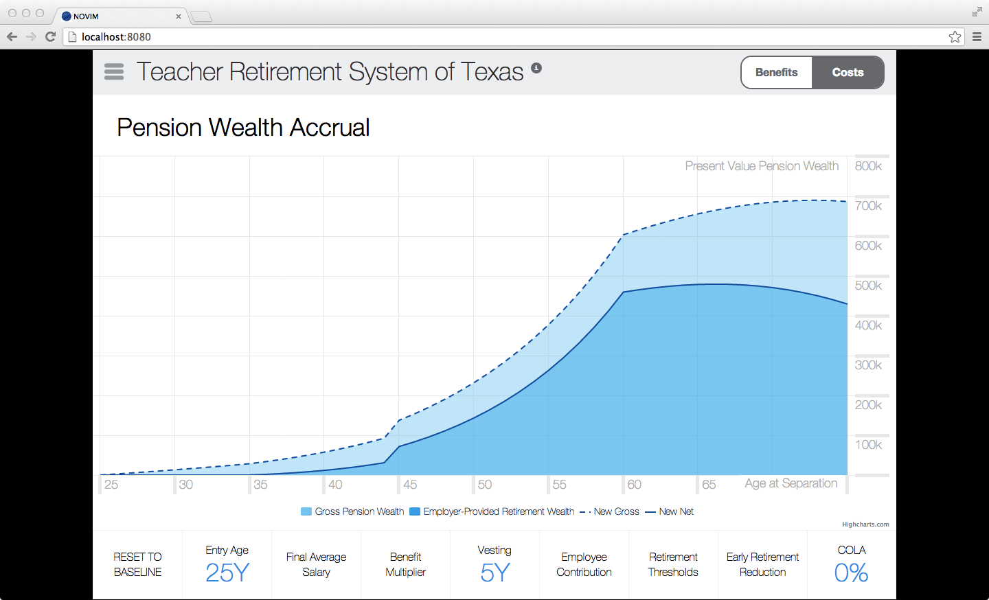
Pension Calc Web App

Slide 26
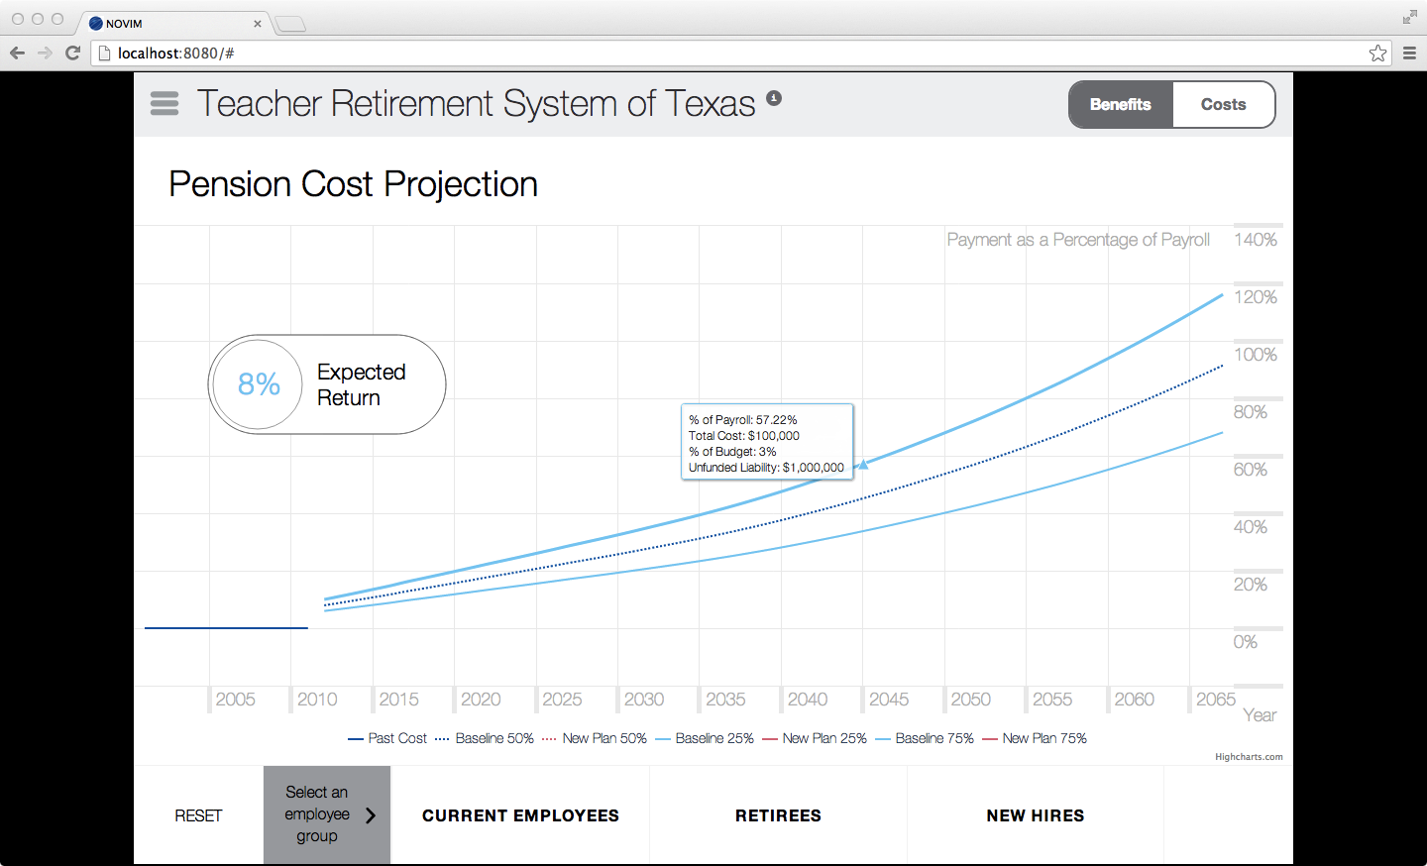
Pension Plan Costs

Slide 27


Thank You
Seth Chandler
Wolfram & the Mathematica community

