Slide 1
Random Variation and Natural Selection in the Evolution of Brains and Ears
NKS DETERMINISTIC RANDOMNESS
Prof. Ray C. Dougherty
Linguistics Department
New York University
rcd2@nyu.edu
BioLinguistics Institute, Dominican Republic

Slide 2
Evolutionary Theory in Biology, Economics, Linguistics… is a purely mathematical problem in Shannon’s Information Theory
CHANNEL
Message
Message
SIGNALS
1
Transmitter
Receiver
Noise
We can show that evolution of human speech and hearing from animal origins must
necessarily have involved qualitative jumps (saltations) from parents to offspring.
We use Mathematica to integrate the works of Noam Chomsky (generative grammar),
Stephen Wolfram (deterministic randomness, CA30), and Claude Shannon (information theory).

Slide 3

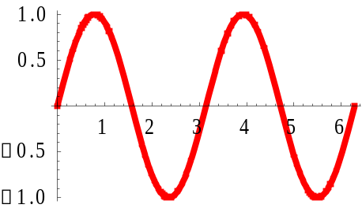
All aspects of the Communication System must be expressed mathematically
CHANNEL
Vibrations in air (Sound Waves)
Message
Message
2
Transmitter
Receiver
Noise
Every signal is a Complex Sine Function.
We only consider a CHANNEL in which the SIGNALS are Sine Functions.
The basic function is: A*Sin[a*x + a’]
We Graph (Plot) or Listen (Play) to Sine functions:
Plot[3*Sin[2*x + Pi/4],{x,0,2*Pi]
The simplest Sine Function

Slide 4

Chomsky’s Generative Grammar can define a ‘Sentence’ for each SIGNAL COMPLEXITY of Sine Waves
CHANNEL
Vibrations in air (Sound Waves)
Message
Message
3
Transmitter
Receiver
Noise
Complex Sine Functions are Chomsky type Sentences using Mathematica Symbols.
Basic A*Sin[a*x + a’]
AND A*Sin[a*x + a’] & B*Sin[b*x + b’]
PLUS A*Sin[a*x + a’] + B*Sin[b*x + b’]
MULTIPLY A*Sin[a*x + a’] * B*Sin[b*x + b’]
AND RECURSION A*Sin[a*x + B*Sin[b*x + b’]]
…
DUAL AND RECURSION A*Sin[a*x + B*Sin[b*x + b’]] + C*Sin[c*x + D*Sin[d*x + d’]]
There exist an infinite number
of sentences, each defining a
Sine Wave Complexity.

Slide 5
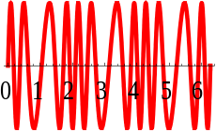
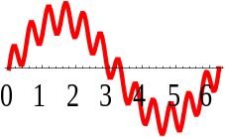
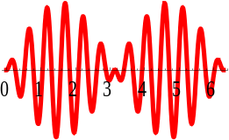
The Chomsky Sentence for each Signal Complexity of Sine Waves is the LABEL or NAME or DEFINITION of the Communication System that uses Sound Waves (Auditory Channel).
There exist an infinite number
Of sentences, each defining a
Sine Wave Complexity.
In Chomsky’s Linguistics
these are SENTENCES, i.e.,
strings of symbols.
CHANNEL
Vibrations in air (Sound Waves)
4
Transmitter
Receiver
Noise
Complex Sine Functions are Chomsky type Sentences using Mathematica Symbols.
Each Chomsky Sentence is a
Mathematica Function that can be
executed and analyzed. It defines the
properties of that specific Communication
system.
Basic A*Sin[a*x + a’]
AND A*Sin[a*x + a’] & B*Sin[b*x + b’]
PLUS A*Sin[a*x + a’] + B*Sin[b*x + b’]
MULTIPLY A*Sin[a*x + a’] * B*Sin[b*x + b’]
AND RECURSION A*Sin[a*x + B*Sin[b*x + b’]]
…
DUAL AND RECURSION A*Sin[a*x + B*Sin[b*x + b’]] + C*Sin[c*x + D*Sin[d*x + d’]]
THIS LIST IS INFINITELY LONG

Slide 6
Chomsky’s Generative Grammar can exhaustively enumerate all conceivable Sine Signal Complexities
CHANNEL
Vibrations in air (Sound Waves)
Message
Message
5
Transmitter
Receiver
A Chomsky Generative Grammar can define a function for all and only conceivable Sine Signal Structure Complexities in a Shannon Information Theory Communication System.
A SENTENCE is a string of elements taken from a fixed list of elements.
  The list of symbols (alphabet) is Mathematica notations and functions.
A LANGUAGE is a set of grammatical sentences.
  A sentence (Complex Sine Function) is grammatical if it runs in Mathematica.
A GRAMMAR is a program that recursively enumerates all of the sentences of the language.
  Our Grammar exhaustively enumerates all conceivable Sine signal structure complexities.

Slide 7
The Chomsky Grammar that defines Sine Signal Complexity uses Mathematica functions as its alphabet
CHANNEL
Vibrations in air (Sound Waves)
One sentence for each Sinusoidal Signal Complexity.
Transmitter
Receiver
6
If Mathematica Notations spans the space of all conceivable mathematical operations,
then the Chomsky Sentences defining Sine Signal Complexity
must span the space of all conceivable Information Theory communication systems that
use Sinusoidals (Sound waves, electrical waves…) as signals.
If the Chomsky Sentences composed of {Sin, &, +, *, ],[, }, {, etc.} exhaustively define the
Signal Complexity and simultaneously label all conceivable acoustic (or any wave based)
communication systems that can be analyzed in terms of mathematics and computation,
We must conclude:
Any animal (or biological or inanimate) Sine wave based communication system
must necessarily be defined by one or more Chomsky-type Sentence(s).

Slide 8
The Chomsky Grammar generates Sentences defining Conceivable Sinusoidal Complexity in a Shannon Information Theory system
We assume Mathematica is ‘complete’ and offers an exhaustive list of basic mathematical functions.
We assume that the Chomsky Grammar is recursive and offers an exhaustive list of all conceivable Sinusoidal Signal Complexities in a Shannon IT System.
We assume any Sine Wave Based IT communication system (biological, television, internal to cell, in a neuron…) must correspond to one or more Chomsky Sentences, which can be executed in Mathematica as a program.
7
If our assumptions are true, then:
We can assign a different integer (1, 2, 3…) to each Chomsky Sentence. That is,
we can count (line up with the integers) all conceivable Acoustic systems.
We can ‘order’ the Sinusoidal Complexities along various dimensions. That is,
we can arrange them in (a 12 dimensional) space and label them using
the ordinals: 1st, 2nd, 3rd. We might order them by ‘machine run times’, etc.
BUT. BUT? BUT!

Slide 9
BUT!
If we can align the Conceivable Sinusoidal Signal Complexities with the Integers, then
EVOLUTION OF SIGNAL COMPLEXITIES MUST PROCEDE IN DISCRETE MOVES
So: Evolution of Sinusoidal Signal Complexities must necessary proceed
In DISCRETE MOVES in an abstract FUNCTION SPACE defined by the Chomsky Sentences
generated by a Chomsky Grammar using Mathematica as an Alphabet.
These conventions and notations have at least three consequences:
Evolution of Human Speech from animal origins must have advanced in ‘discrete steps’
in a FUNCTION SPACE where the ‘dimensions’ are mathematical functions (&, +, *…)
and integers (number of Sine functions); and no crucial parameter uses ‘real numbers’.
We can use von Neumann's GAME PLAYING theories of COMPLEXITY since the
CHOMSKY LANGUAGE SPACE has a lot in common with the ‘space’ of chess or TIC-TAC-TOE.
We can use Wolfram’s New Kind of Science analysis of machines in terms of States
and Colors to analyze the evolution of animal communication systems using (CA30)
Cellular Automata. Human cognitive evolution is a case of DETERMINISTIC RANDOMNESS.
8

Slide 10
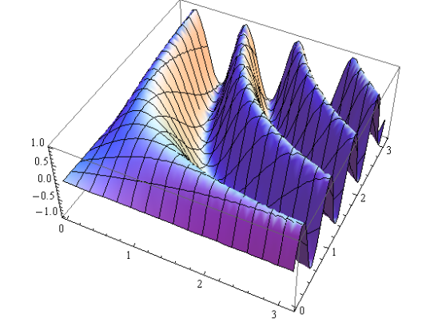
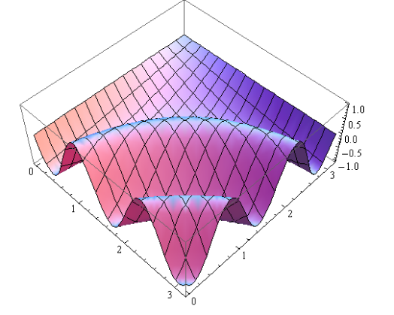
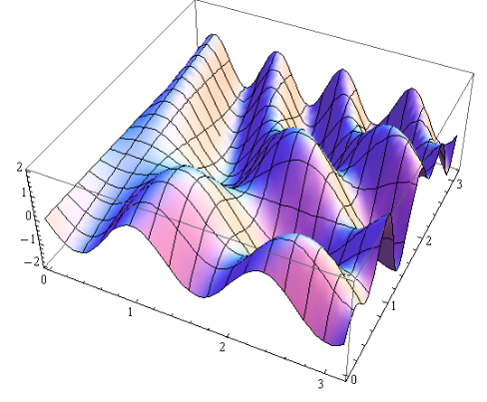
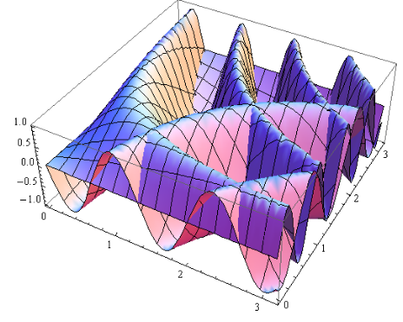
Chomsky’s Generative Grammar can exhaustively enumerate all conceivable Sine Signal Complexities
Two SINE waves intersecting at right
Angles in circular coordinates.
These are orthogonal in
cylindrical coordinates.
9
Sinusoidal A
Some animals can rotate
Their ears and hear ‘polarized
Sinusoidals’: the bat, crickets…
Sinusoidal B
This is impossible in air, but
fine in brain/ear logic circuits.
Sinusoidal A + B
Sinusoidal A & B
The Arithmetic Sinusoidal A+B in air is converted
To the Logical Sinusoidal A &B by the Cochlea.

Slide 11
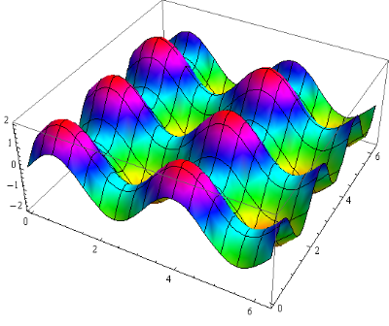
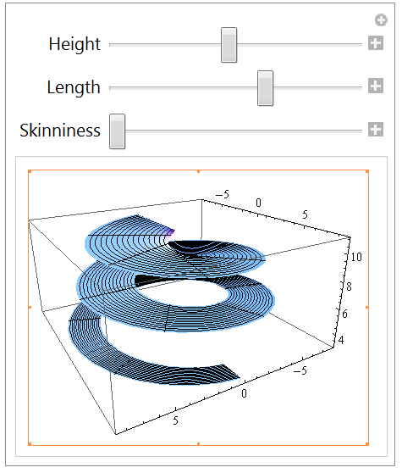
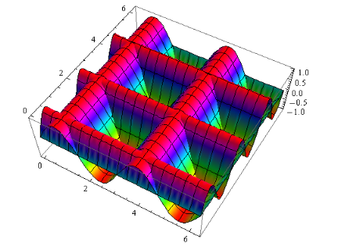
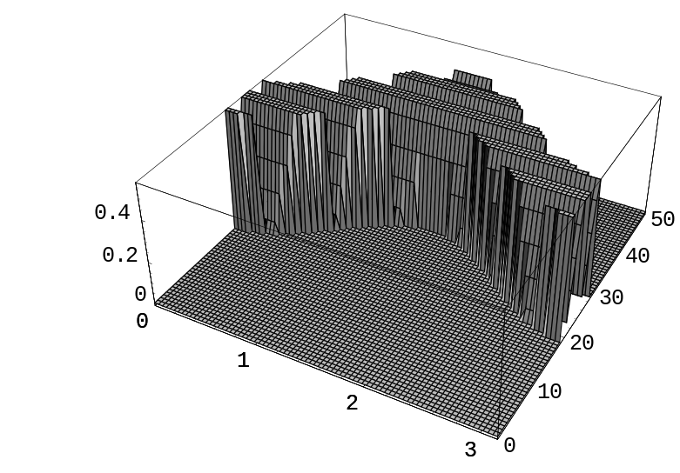
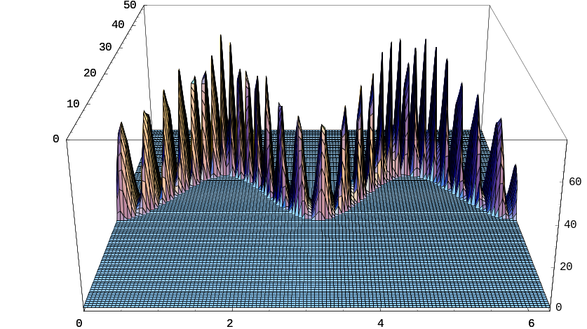
The COCHLEA converts Sinusoidal Complexity from PLUS to AND, and ‘discrete Frequency Modulation’ to ‘continuous Frequency Modulation’.
Cochlear view
of vocal cord harmonics
10
Sinusoidal Vibrations in air,
from ‘vocal tract’ (PLUS not AND)
Sinusoidal Electrical Signals in brain/ear.
Logical Sine Functions, (AND, not PLUS)
The COCHLEA converts Analog->Digital.
Vocal cord
harmonics
OUTSIDE HEAD
Sine Waves PLUS
Analog world
INSIDE HEAD
Digital world
Sine Waves AND
Cochlear view of vocal cord harmonics

Slide 12












Evolution of Language Spaces and Von Neuman’s Economic Game Theory
(Economics is of course Linguistics)
Equivalent Grids
12
Equivalent Grids
Etc.
{A,B,C,D,E,F,G,H,I} Each Letter can be 0 = BLANK, 1 = X, 2 = O.
Each CONCEIVABLE BOARD CONFIGURATION is a number in the TRINARY Number system.
000 000 000 trinary = 0 in decimal
222 222 222 trinary = 19,638 in decimal
Each conceivable GRID is a number 0 to 19,638.
CHUTES AND LADDERS
Of the 19,638 conceivable boards,
about 6000 are possible in any game,
and many of these are ‘equivalent’.

Slide 13
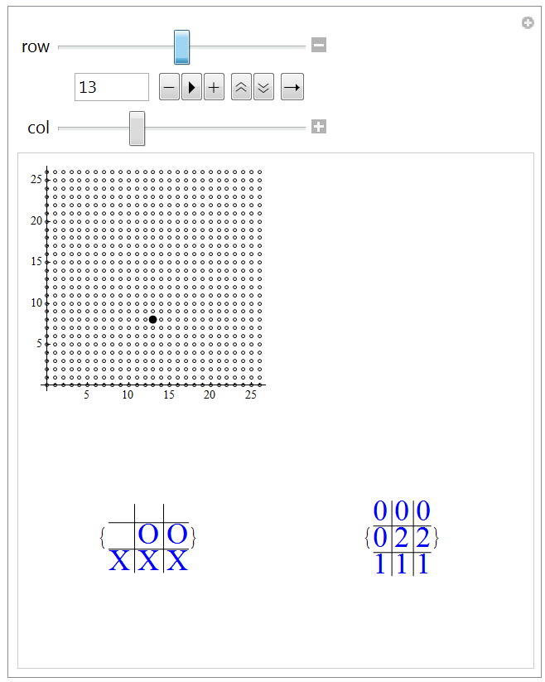
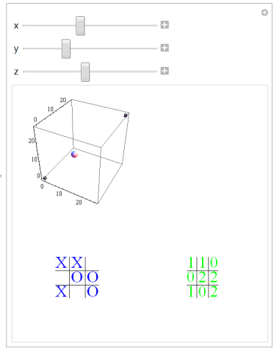
Tic Tac Toe has 19,683 Conceivable Board Configurations
This cube exhaustively
enumerates the boards.
This cube contains
a point for each of the
Conceivable Tic Tac Toe
Board Configurations.
13
A GAME consists of the
Sphere moving from one
Possible point to another.
A 2Dim 27 by 27 grid of the lower two
rows of the Tic Tac Toe board, 3^6=729
Conceivable Board Configurations.
A 3Dim 27 by 27 by 27 cube of the three
rows of the Tic Tac Toe board, 3^9=19,683
Conceivable Board Configurations.

Slide 14
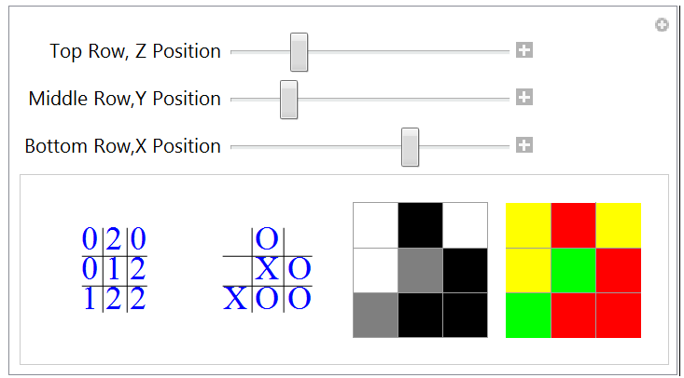
One can use NKS State-Color Conventions to Represent Tic Tac Toe in Cellular Automaton Notation.
14
An Exhaustive Enumeration of the Conceivable
Tic Tac Toe Boards as (A) points in an abstract
3 Dimensional ‘state space’, and (B) as ‘State Color’
Diagrams like those of Cellular Automata.
There are 19,683 conceivable grids.
There are about 6,000 possible grids.
Regions of the cube can never be visited.

Slide 15
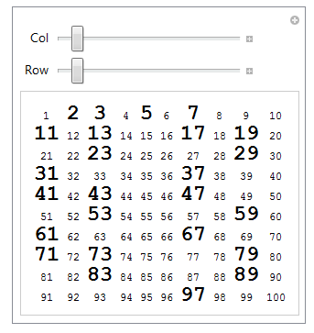
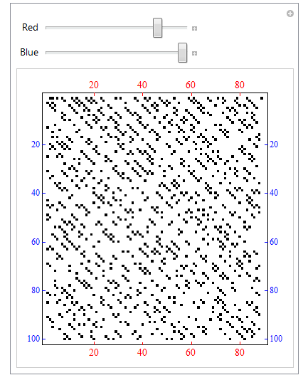
Deterministic Randomness
Cellular Automata 30 and Prime Numbers
Prime Numbers in a Grid as Numbers and as Graphic Dots, Random or Patterned?

Slide 16
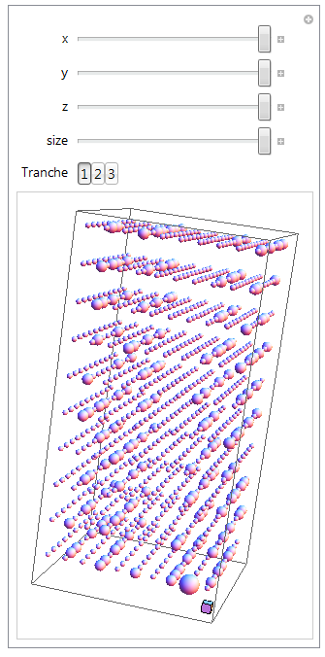
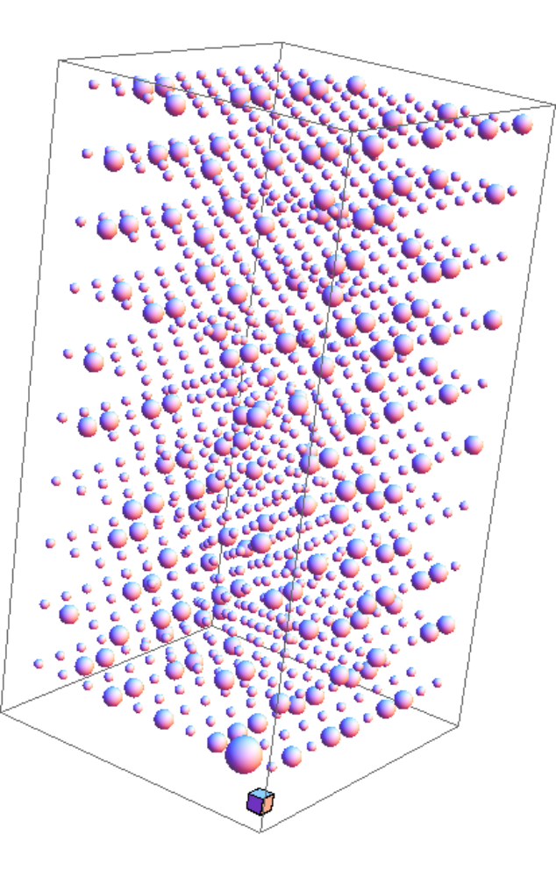
Prime Numbers in a 3 Dimensional Grid
Alan Turing’s Day Dreams
The first 1,000 Primes.
The Process of Evolution that gave rise to the complexity of human speech from animal origins is an example of DETERMINISTIC RANDOMNESS, as one finds in the Primes and in Cellular Automaton 30.
Evolution of Sine Wave Communication Systems takes place in a Well-Defined Mathematical Envelope that narrowly constrains VARIATION to Mathematical Possibilities in Information Theory.

